Slide 1


Veszprém-Balaton 2023

Slide 2

Building the Culturally Smart City
People, Place, Programme,
Passion

Slide 3
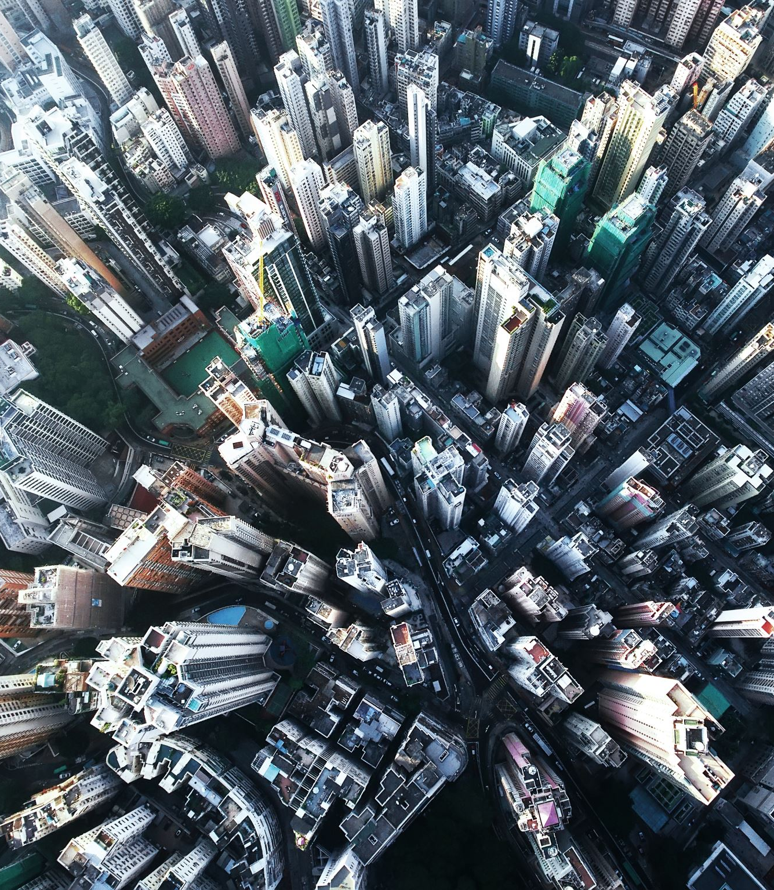
Cities are (mostly) on the move

Slide 4
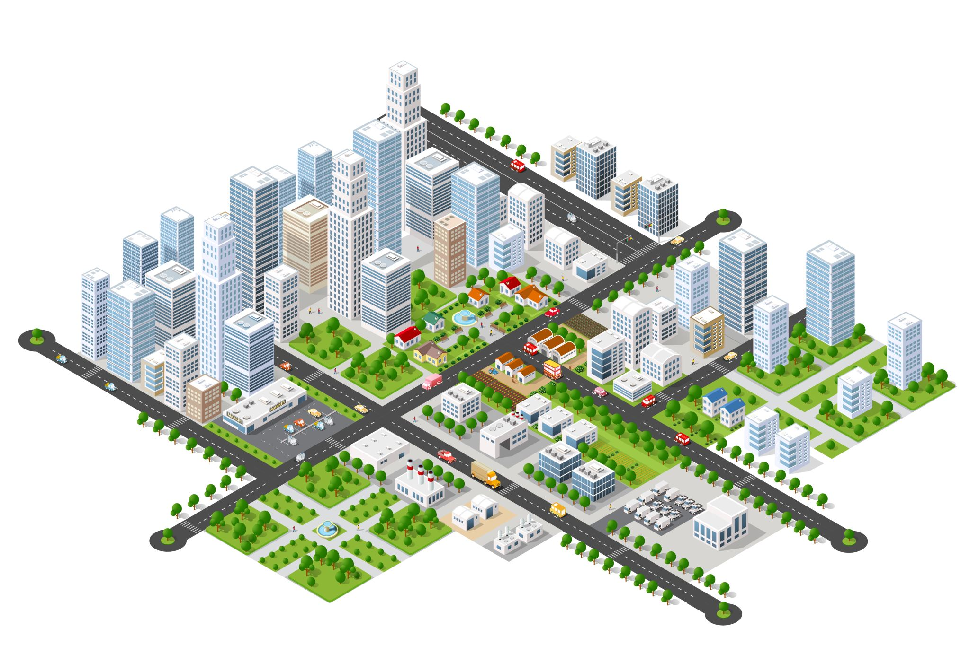
But is it always people first?
“Smart City” – cold, techno, distant?
Urban development
Infrastructure
Regeneration
Economic development
Roads, offices, housing “developments”
Where do the people come in?

Slide 5
What about being culturally smart?
“Culture led regeneration”
Cultural regeneration
Culture as 2nd strategy
Cultural compacts
…Lots of terms but where are the results?

Slide 6
People: How, Why and What?
Belonging
Community
Participation
Co- creation
Reaching new audiences
Health and well-being
Volunteering
Happiness
Civic engagement

Slide 7
Strategic Problems:
Searching for Solutions
Cultural audience is educated, middle-aged, female
“Top” 10% receive most benefit from cultural spend
Big city bias – what does this mean for Veszprem?
Funding focus on city centre and traditional institutions
Some communities feel their “culture” is not recognised
“Dying” city centres
18-30 generation struggles with relevance
Pandemic has enhanced some problems: but also forces a rethink..

Slide 8
But what does this have to do with European Capital of Culture?
It’s Common Sense, of course!

Slide 9
Here’s where the big event comes in!
Creates a buzz
People give themselves permission …
More visibility and joined up programming
Role for volunteers and ambassadors
Better quality events and exhibitions
Specific programmes eg for Hospitality sector
Shaking up the system
Similar issues from covid

Slide 10
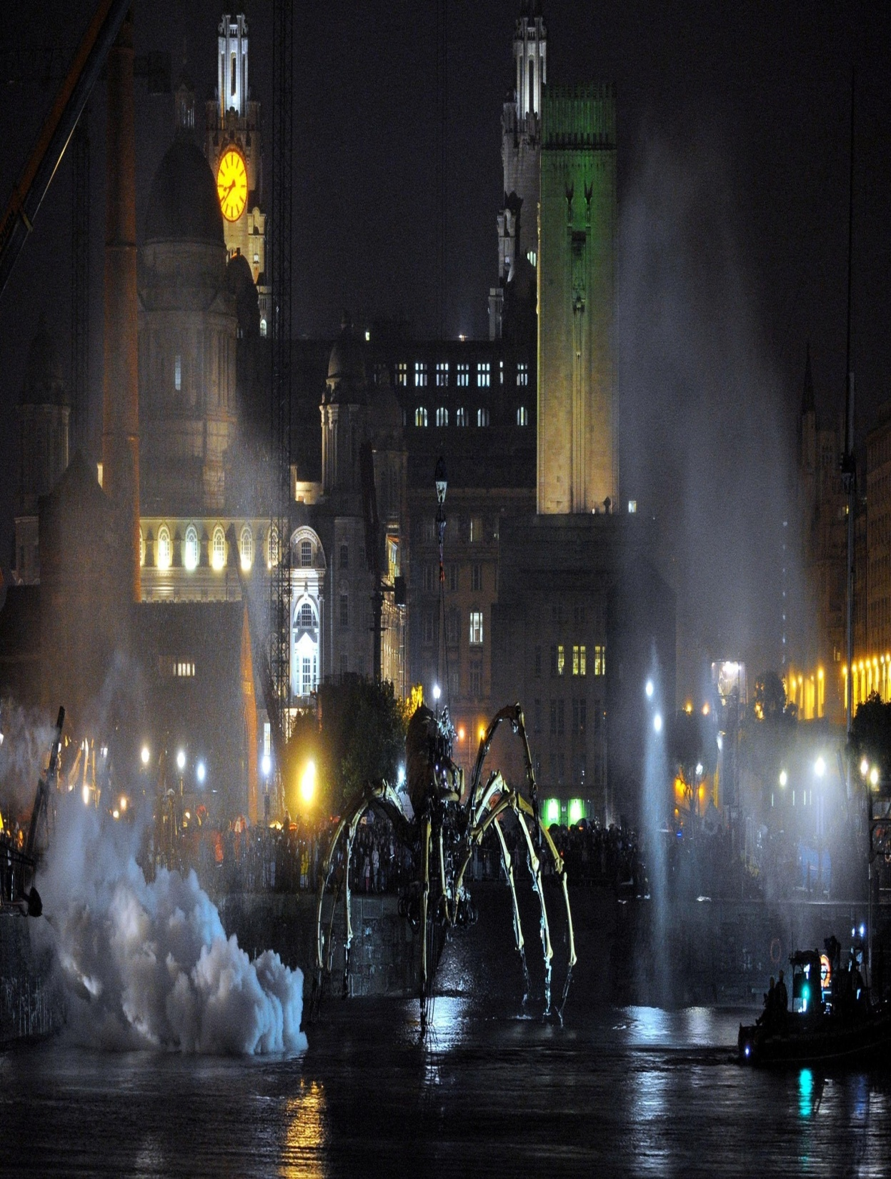
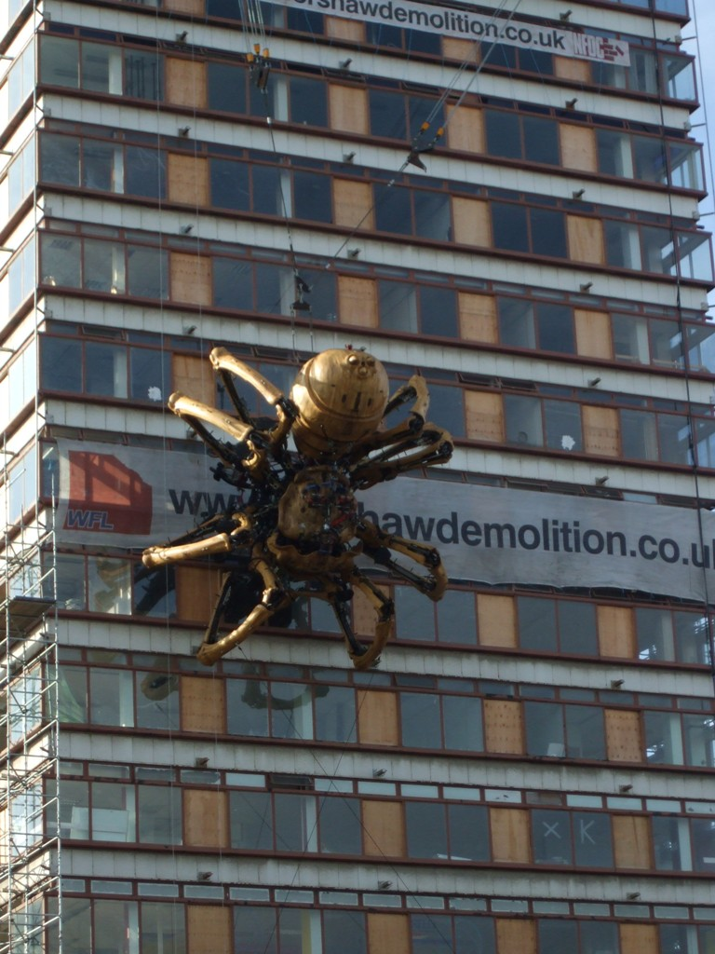
La Machine:
Liverpool 2008
Notes:
10
And of course September brought the giant spider La Princesse and 200,000 people turned out to watch her make her way round the city.

Slide 11
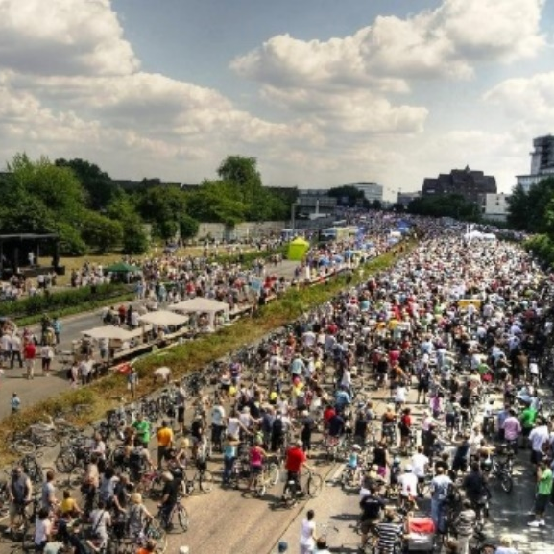
Stop the City: Ruhr 2010
Huge regional programme
Revitalise the image of Ruhr area
Big population
Needed “connecting” event
Closed the motorway for 1 day
Huge community cultural celebration
“I was there” event!

Slide 12
Experience from European Capitals of Culture (ECoC)
At its best THE most culturally smart programme?
Chance to mix heritage and innovation
Economy-led, tourism-strong models most visibly successful
Social impact – less understood, but more important
And has covid 19 made it more important still?
Can we get more people to participate in cultural life?
Why should they?
“People smiling on the streets ….and that they are happy”
– What culture means to me :Turku, Finland, 2019

Slide 13
Why Do We Need More Participation?
It’s good for you
Active people are healthier and happier
It’s good for society
Active places are more economically and socially successful

Slide 14
Solution 1:
The People
Their Passion
Liverpool “08 Volunteers”
New model for cultural volunteering
Started small (25 people) and grew
Mapped City to recruit from under-represented areas
Part of wider “Liverpool Welcome” programme
1,000+ Volunteers; 7,000 volunteer days
50+ people prominent – “giving back to the city”
Welcoming face of Liverpool – still going
Influenced other ECoC Volunteering and London 2012

Slide 16
Solution 2:
I want my culture where I live!
Taking culture out of the cultural quarter
Kaunas (Li) – from cultural desert to Fluxus labs
Transforming relations between people and place
Kosice (Slovakia) – SPOTS project
Transformation of former heat exchanger stations in 7 city districts
Cultural mapping helped solutions focus on community characteristics
Varied from young people to seniors
Some criticism of location selection
Legacy benefits are still unclear

Slide 17
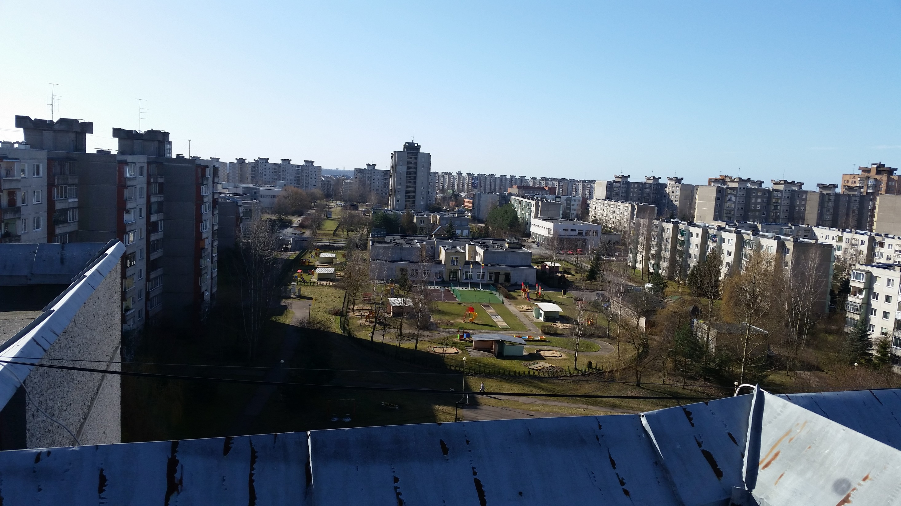
The Housing Estate

Slide 18
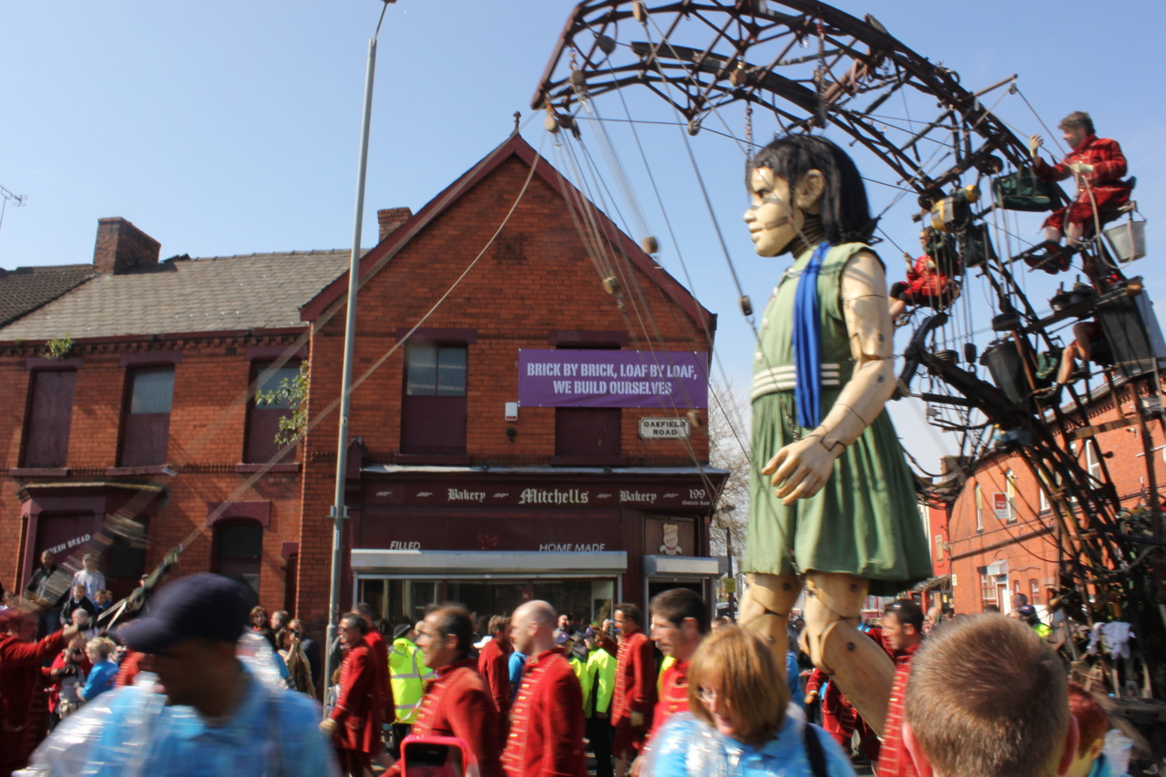
Sea Odyssey 2012 – Liverpool – reaching the parts culture doesn’t reach?

Slide 19
But what happens when the year is over?
How do we create a long-term legacy?
Does this all stop after 2023?
What about those places that don’t have a title?
Don’t despair….
It’s all about P-P-P
People, Place, Programme
…..again it’s common sense

Slide 20
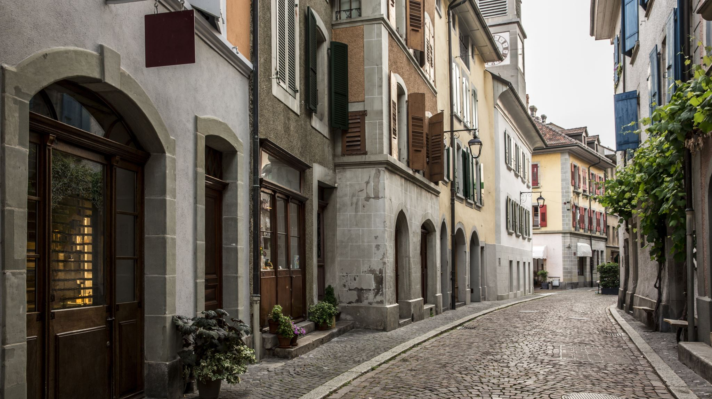
Place 2024 :
What worked best in 2023?
What did we miss?
Don’t go back to “business as usual”

Slide 21
Long term vision
A shared experience for the city
Local passion unlocked
Playful by day – welcoming at night
Refreshed and flexible cultural venues
Joined up and imaginative programming
Spaces which are welcoming and eventful
Sports, participation and culture together
How do we make it happen?

Slide 22
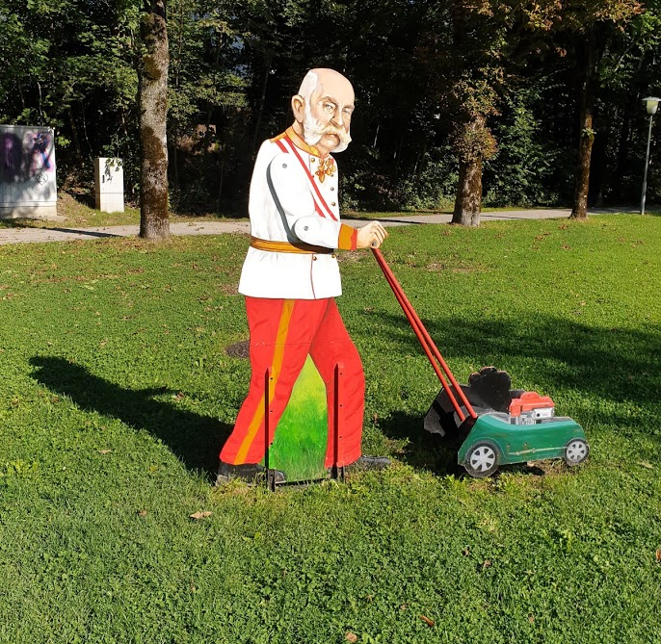
You could play with
tradition!

Slide 23
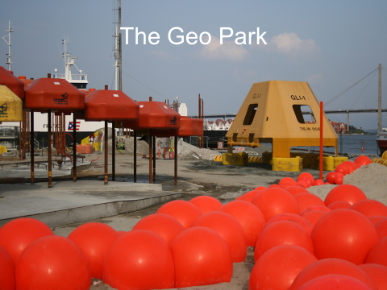
You can make a playful City Centre:
Geo Park – Stavanger (2008)

Slide 24
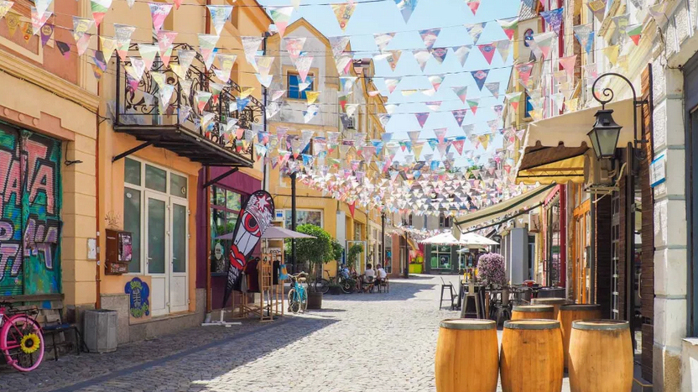
You might develop a new creative quarter…

Slide 25
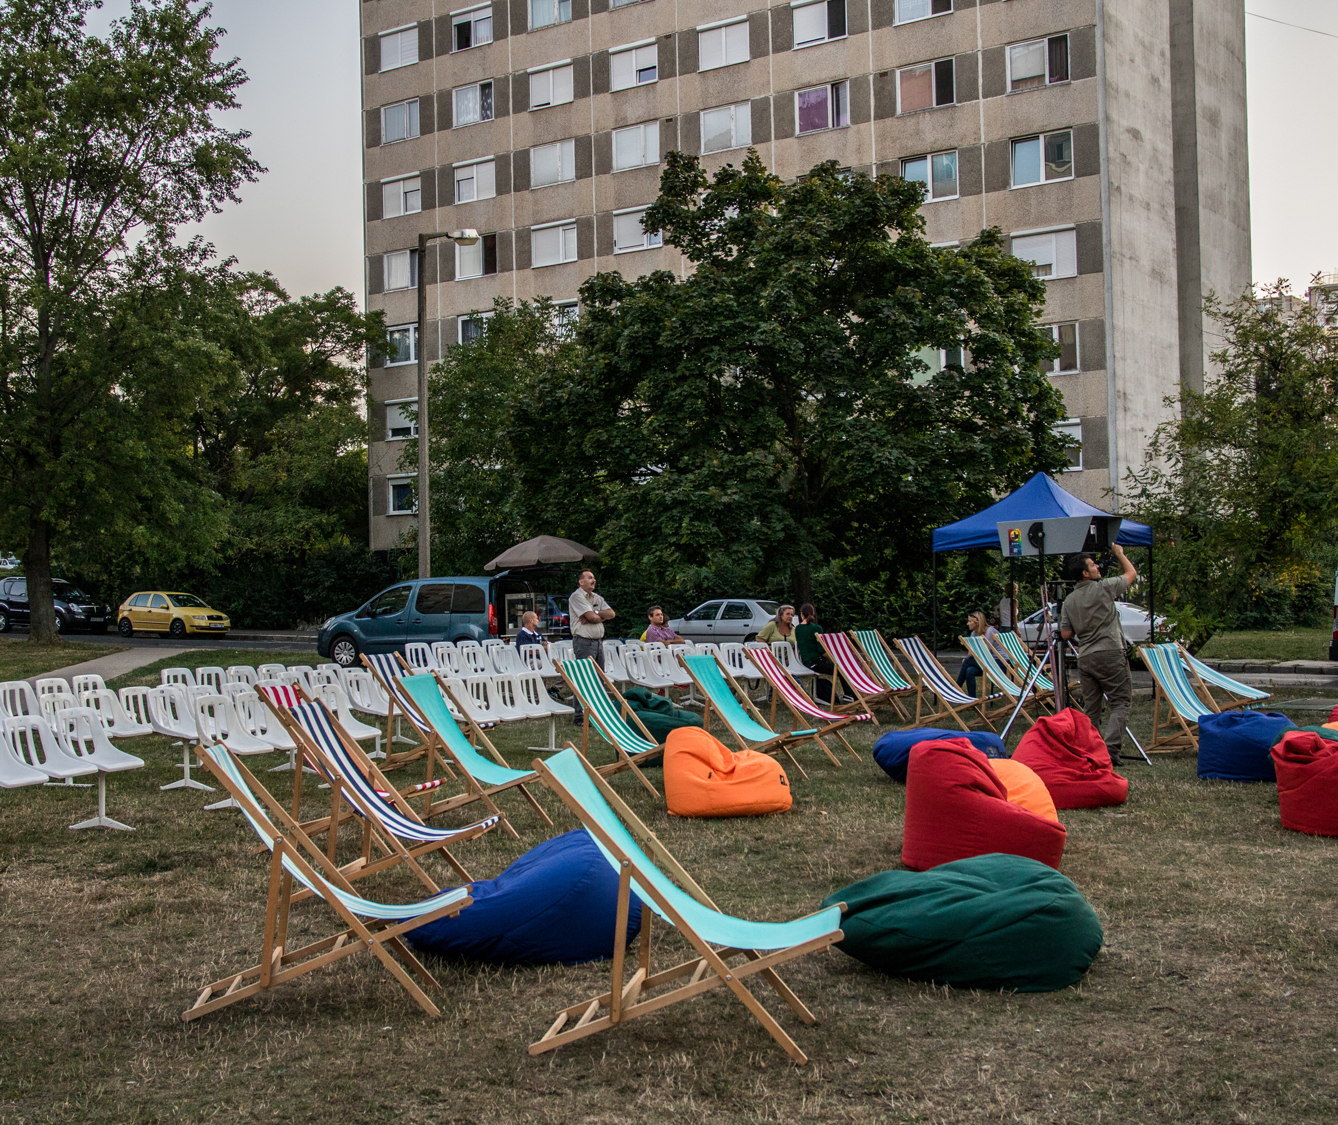
Jutasi Picnic:
You may have rebuilt your main housing estate!

Slide 26

You could look after your audience!
Get to know the audience in 2022/3
New people will get involved with VB 2023
Keep your Volunteer programme going
Think about keeping “attractor events”
Don’t turn off your current audience
Can we create “culture fans”?

Slide 27
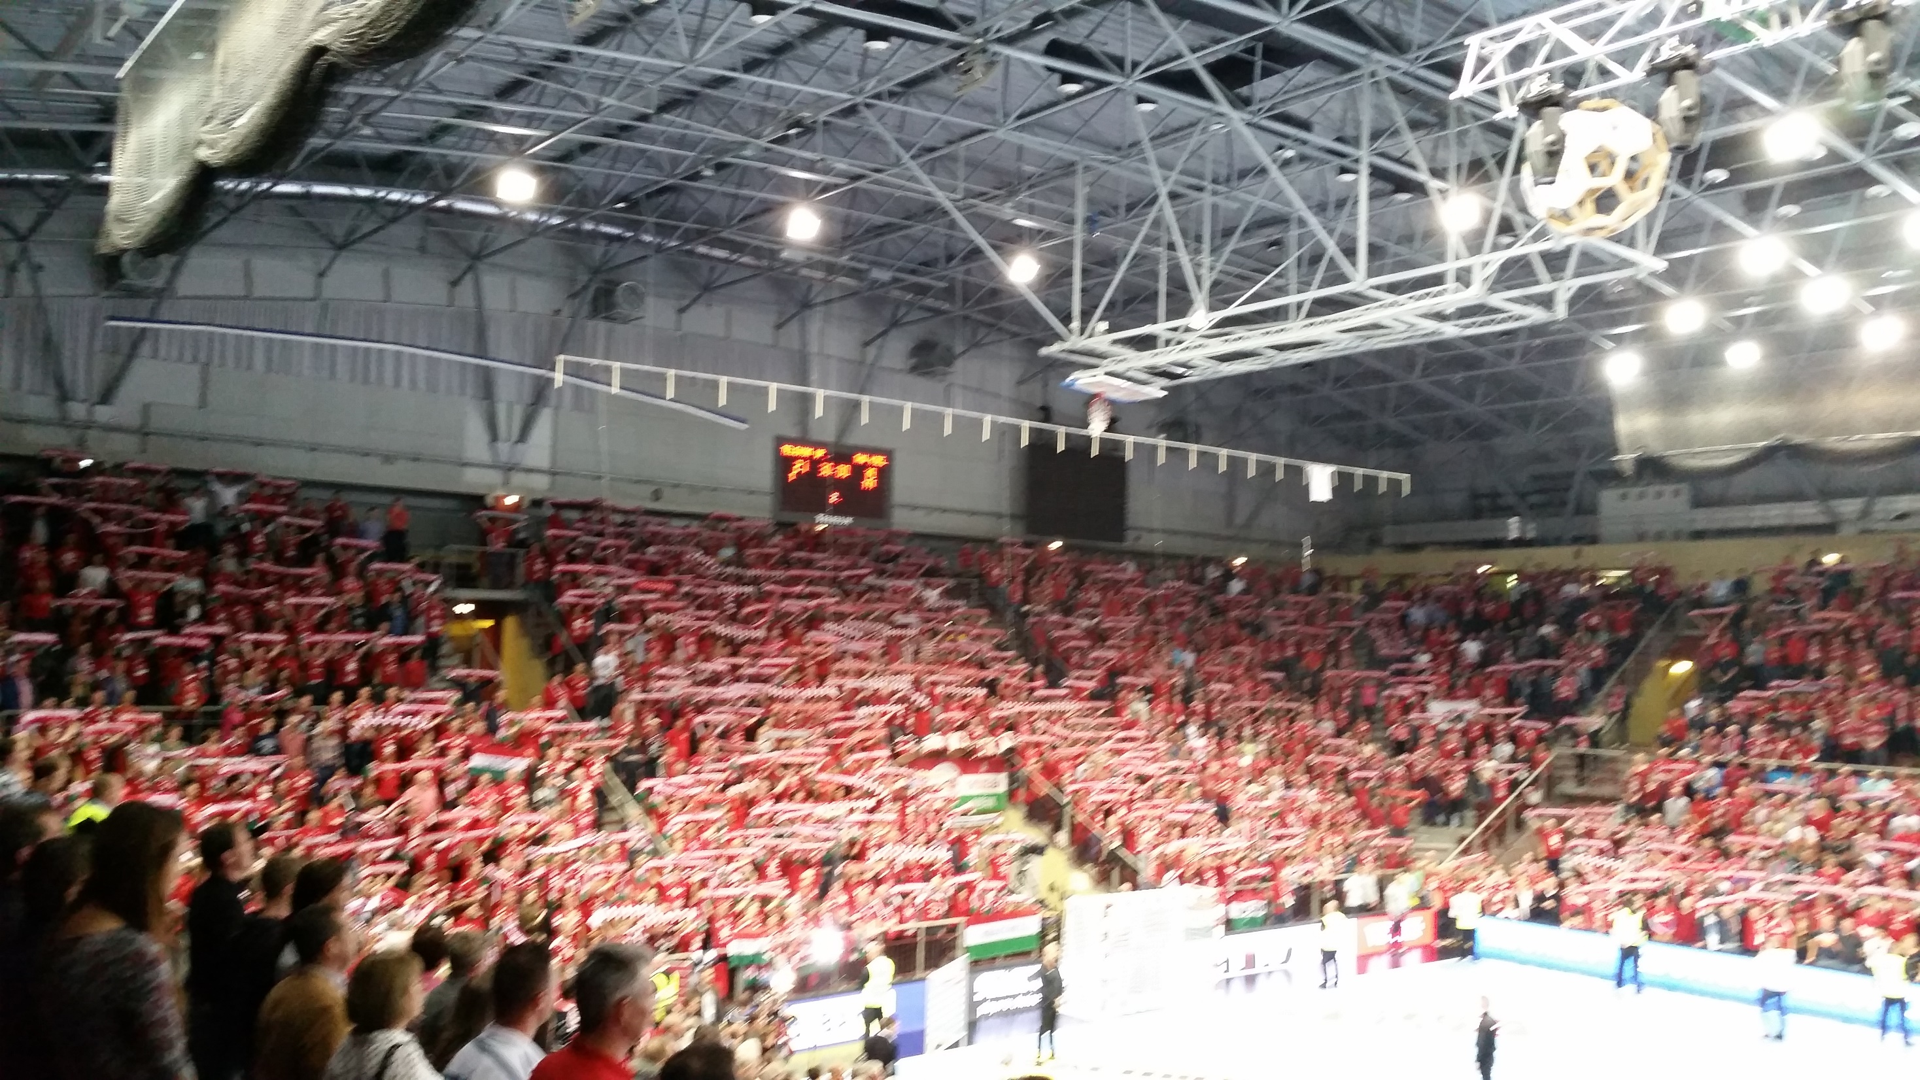
The Model for “culture fans”?

Slide 28
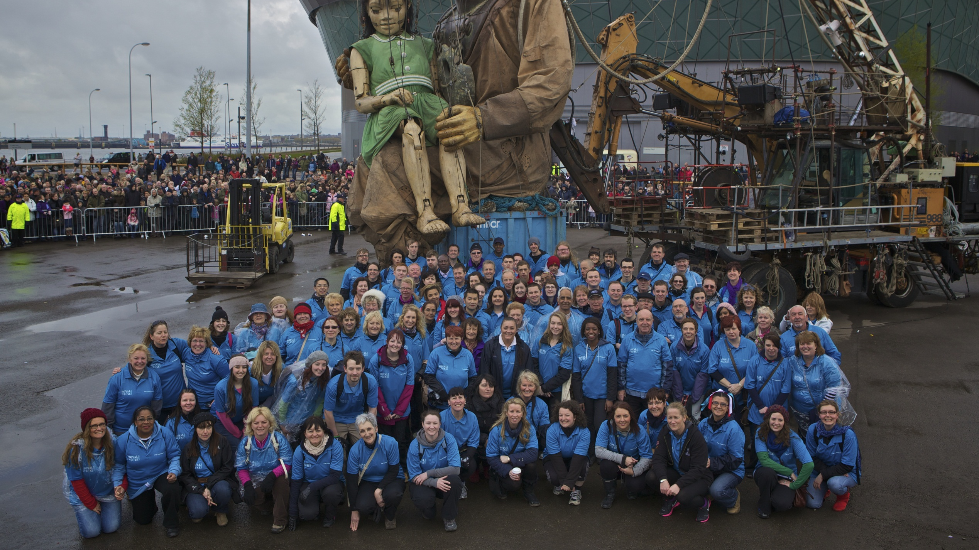
You could keep developing new events:
Liverpool 2010

Slide 29
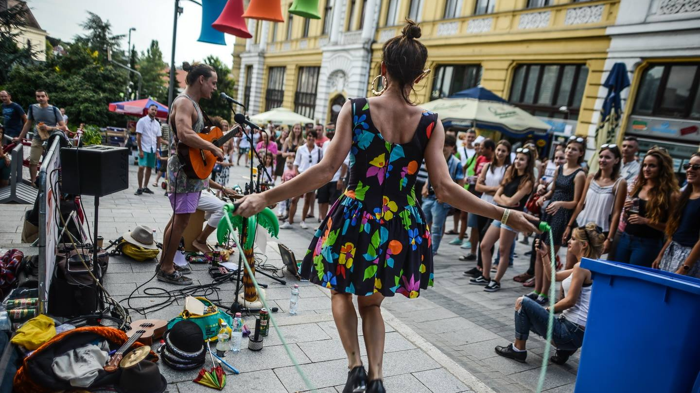
Or you can develop and expand your best ones

Slide 30
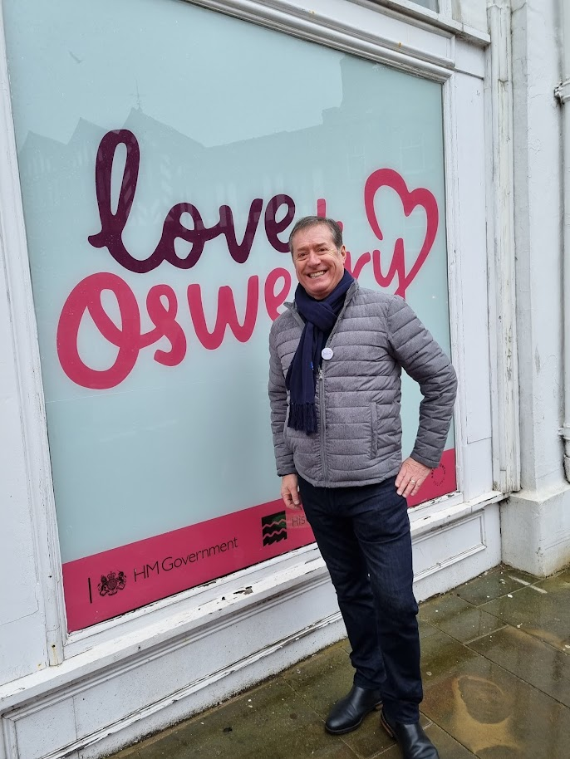
You can develop new models for smaller city development
Heritage Action Zone
Cultural Consortium
Cultural Improvement Districts
……
Become a centre of excellence for creative placemaking

Slide 31

You can build
A great programme for 2023
A way to transform the relationship between people and city
An organisational structure to build on VB 2023
A region that goes far BEYOND what it was in 2016
A new model for smaller cities to be culturally smart
But you need to be a part of it…It won’t happen without you
That’s just Common Sense!

Slide 32
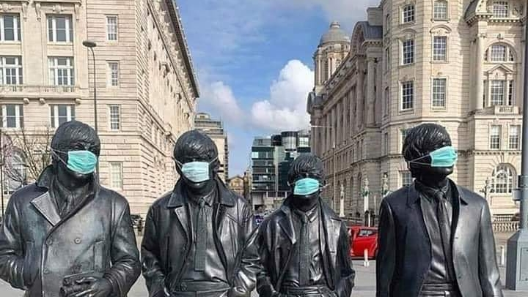
We Can Work It Out!

Slide 33
Thank You
Kossi

Slide 34
Zinneke Parade
23.03.2022
Beyond Cultural Quarters - Common Sense - Veszprèm
Obay Al Bitar et Perrine Deltour

Slide 35
Presentation outline
Zinneke, a brief introduction
  The origins of the Zinneke Parade : Bruxelles/Brussel 2000, European city of culture
    Political, urban and social Context
    Three foundational projects
Zinneke Parade today : strategies, practices and challenges
    Terminology and founding of an association
    Zinneke today : purpose, methodology and challenges
Zinneke 2030 : aspirations and future trajectory

Slide 36
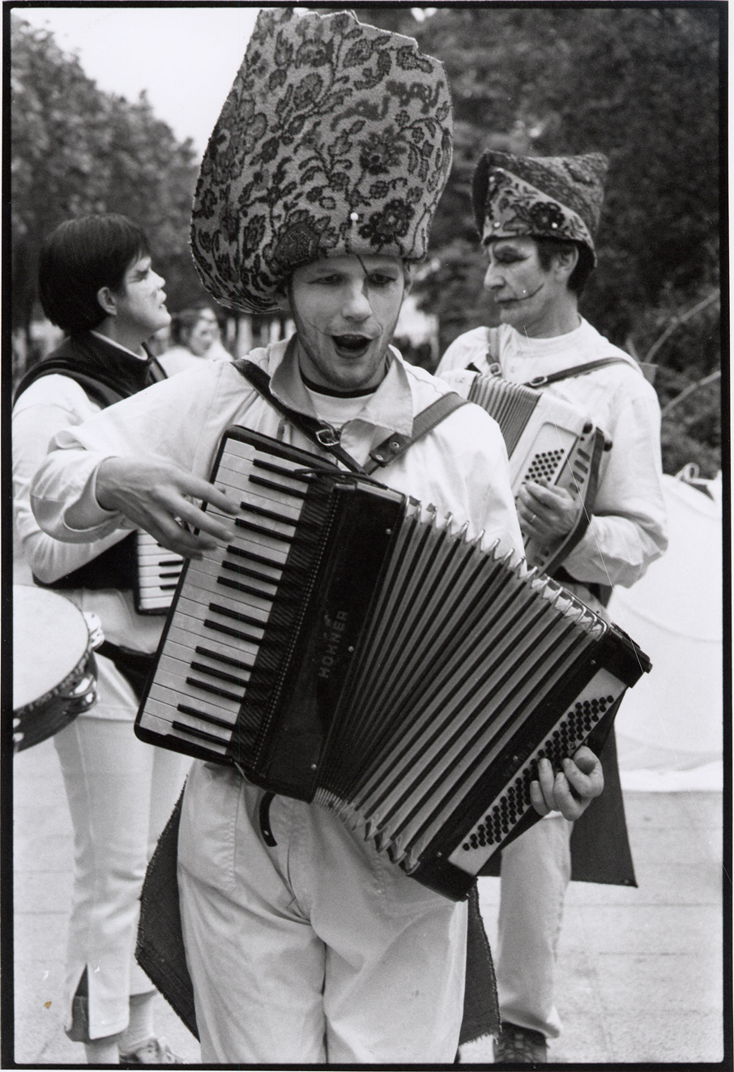
Zinneke, a brief introduction
A city project with a socio-artistic practice at its core ;
participation of inhabitants of diverse
neighbourhoods of Brussels ;
in collaboration with a local network
of groups and organisations ;
through an intensive process
of 1.5 years of outreach, encounter,
collaboration and creation with artists ;
Resulting in an artistic parade in the city of Brussels.
cc I. Roels

Slide 37
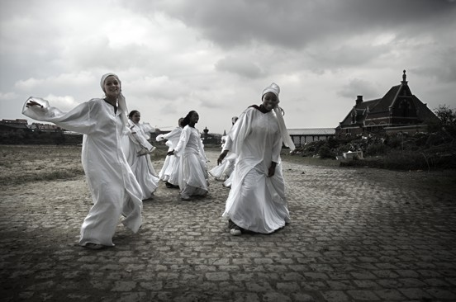
Bruxelles/Brussel 2000, European city of culture
The event revealed/highlighted three political, urban and social issues facing brussels :
  Political and linguistic divisions between Flemish and French speaking communities.
  A lack of a clear and unified Brussels urban identity.
  Economic disenfranchisement of working class neighborhoods.

Slide 38
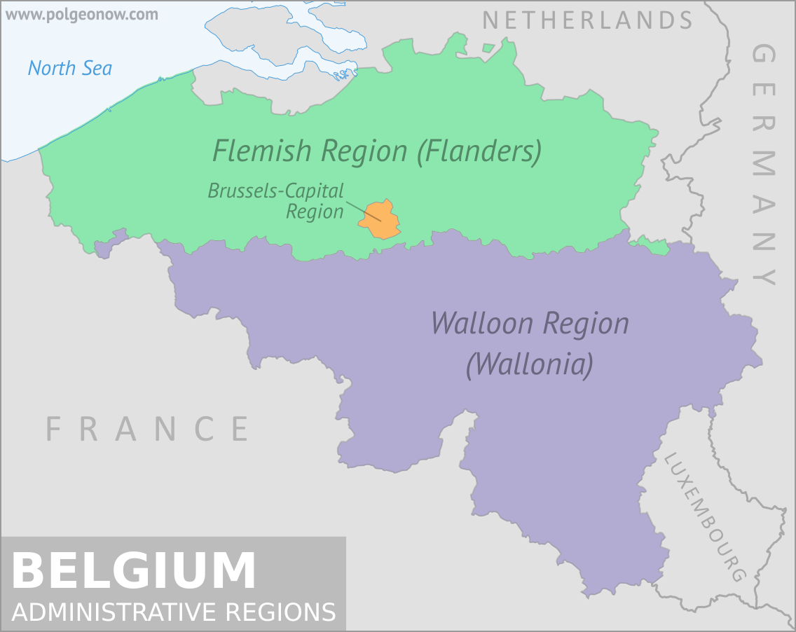
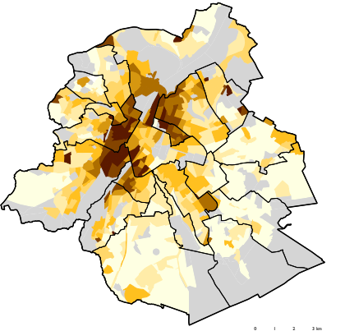
Bruxelles/Brussel 2000, European city of culture

Slide 39
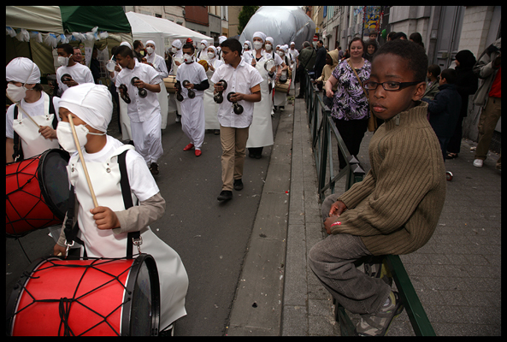
The origins of the Zinneke Parade : Three foundational projects
Zinneke’s conception : three foundational projects
  Brussels ‘ folkloric Carnival ’
  “ Decentralization of cultural institutions” by developing different Cultural Centers in other districts
  Building symbolic bridges between the City-Center and the neighbouring districts

Slide 40
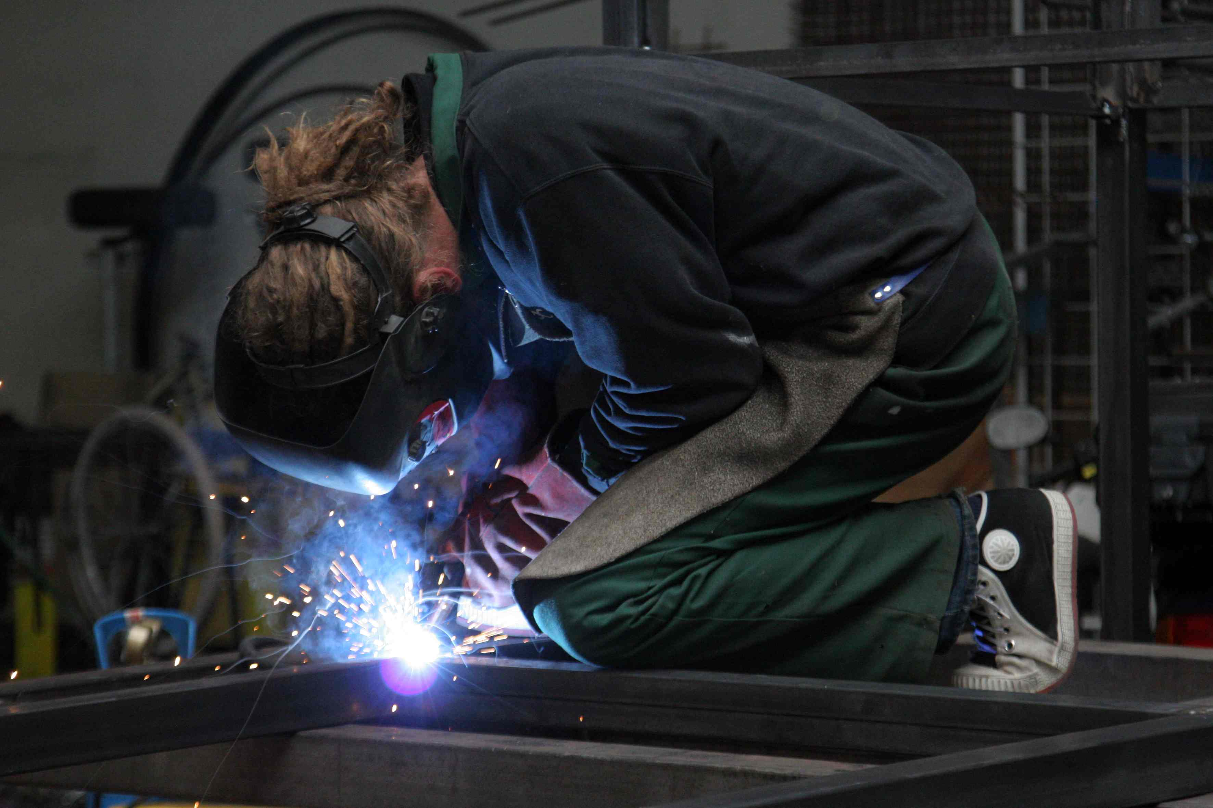
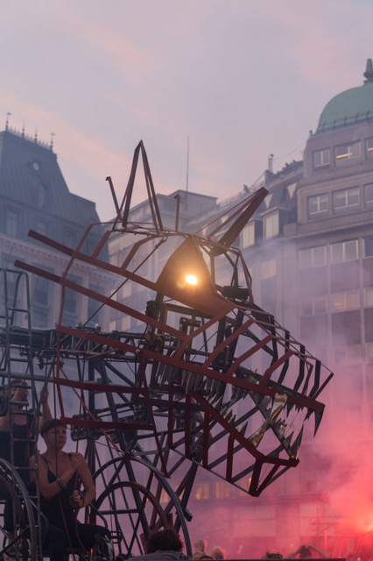
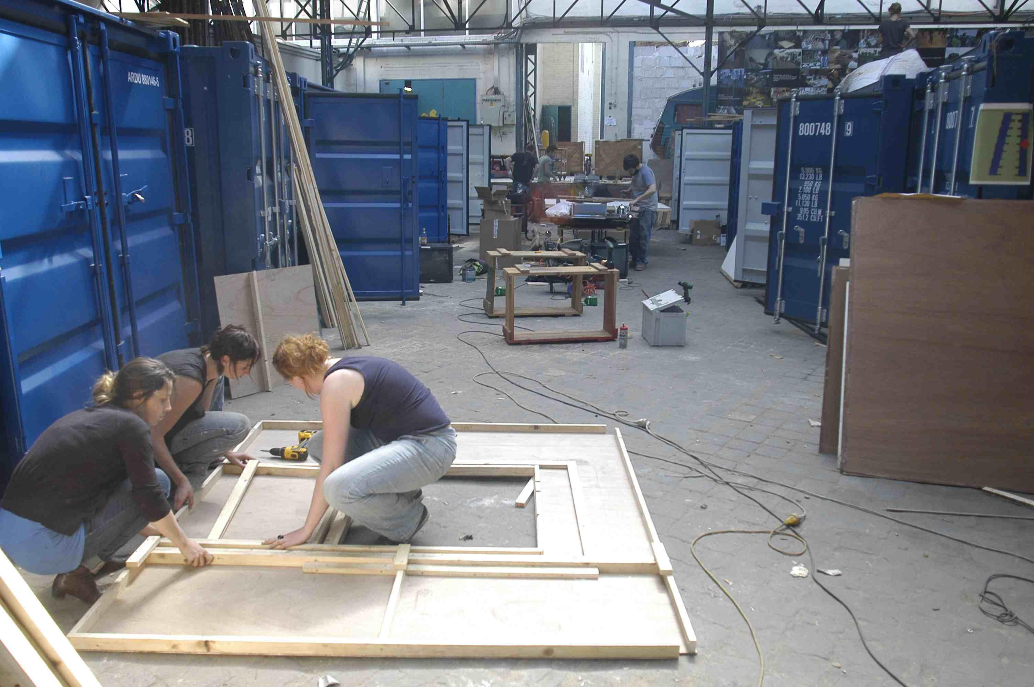
Zinneke Parade : strategies, practices and challenges
Zinneke - Terminology.
Founding of an association to ensure the continued development of participatory socio-cultural practice in Brussels.

Slide 41
Zinneke Parade : strategies, practices and challenges
Zinneke Parade today
  Collaboration, collective creation, and coproduction ;
  Appropriation of public spaces as shared space ;
  Focus on DIY and DIT activities/initiatives ;
  Emphasis on breaking down intra-Brussels, communitarian and inter-city barriers.

Slide 42
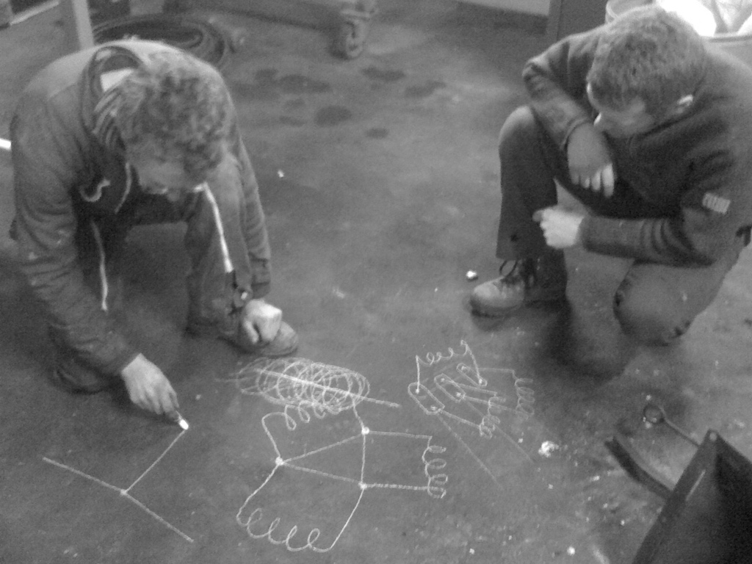
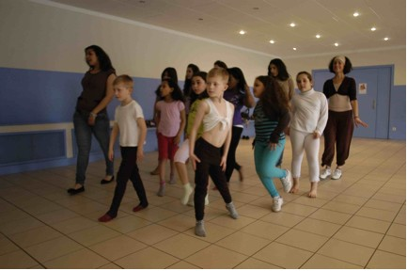
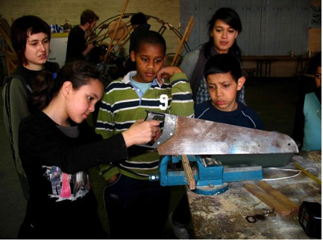
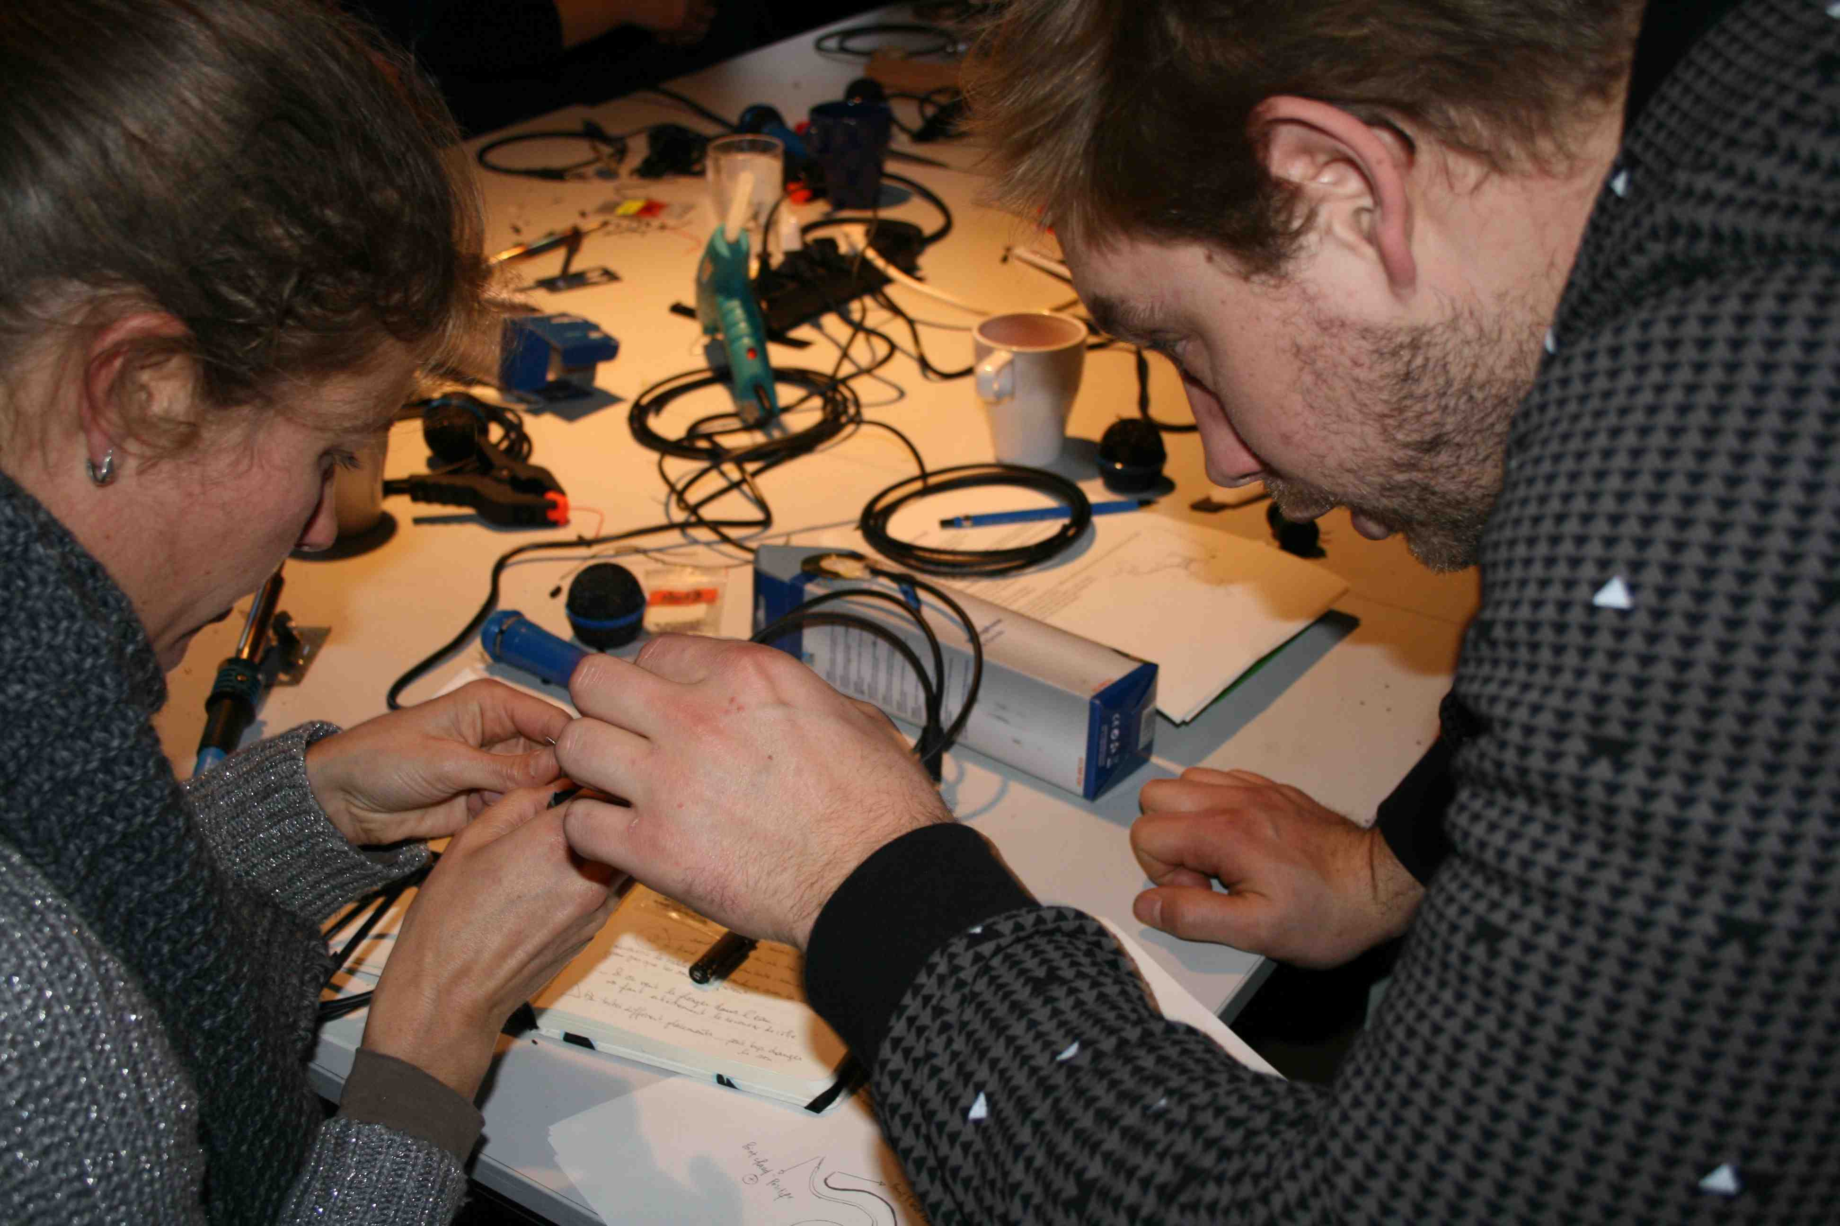
Zinneke Parade : strategies, practices and challenges
Methodology :
    Identification and outreach to local actors involved in their neighborhood.
    Creation of a “Zinnode ” together with local actors (professional artistes, local institutions and inhabitants).
    A process of participatory creation.
    Conception of an artistic project.
    Artistic project performed on the day of the parade.

Slide 43
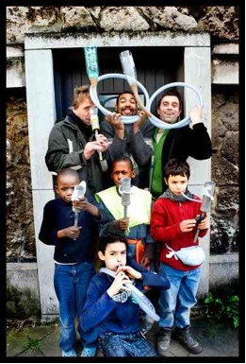
Zinneke Parade : strategies, practices and challenges
  Challenges
    Procurement of subsidies and navigating the particularities of French and Flemish regional governmental institutions.
    Potential of institutionalization.
    Urban cultural event for Brussels residents or for tourists?
    Maintaining the balance between sociocultural and artistic approaches.
    ‘Overall’ approach: Reinforcement of shared Brussels identity or deepening the divide between Neighborhoods?
    Tradition: Starting point for exchange and embrace of change or strict adherence to tradition?
cc Saskia Vanderstichele

Slide 44
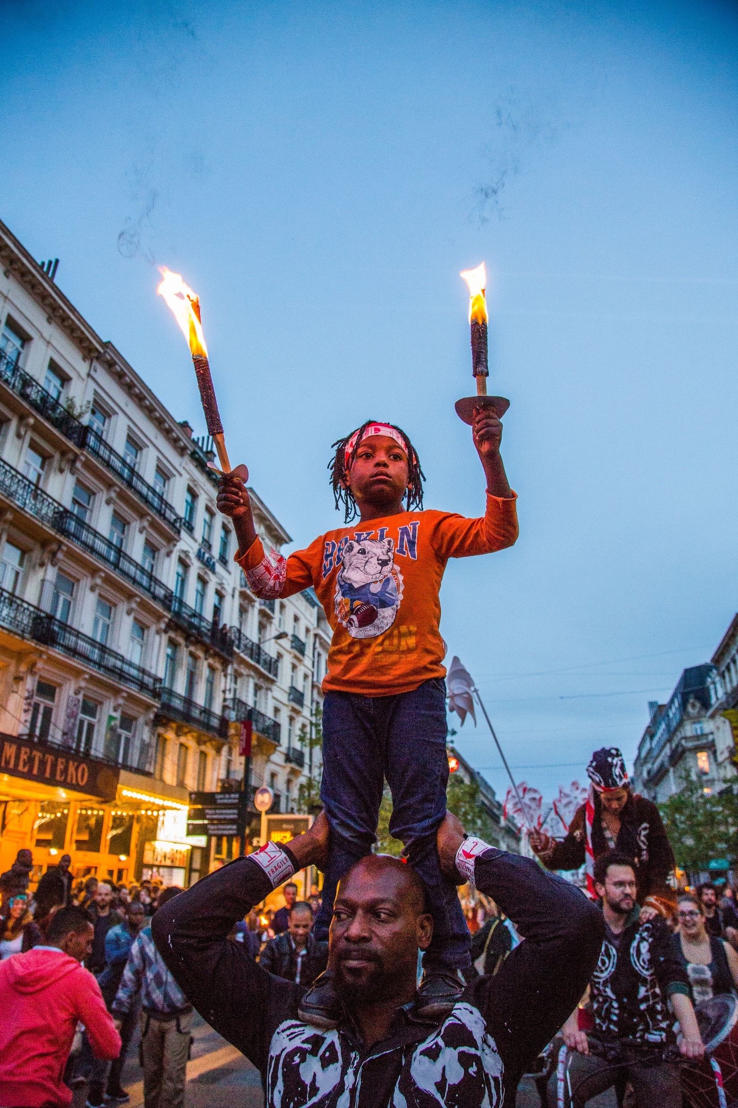
Zinneke 2030 : aspirations and future trajectory
Participation: shift towards greater engagement with local citizens rather than institutions.
Rethinking of current practices and methodologies for a changing Brussels.
Introducing a new chapter : New Zinneke event between parades.
Increasing presence and engagement in public spaces.
Masui : a production Centre for the Zinneke Parade.

Slide 45
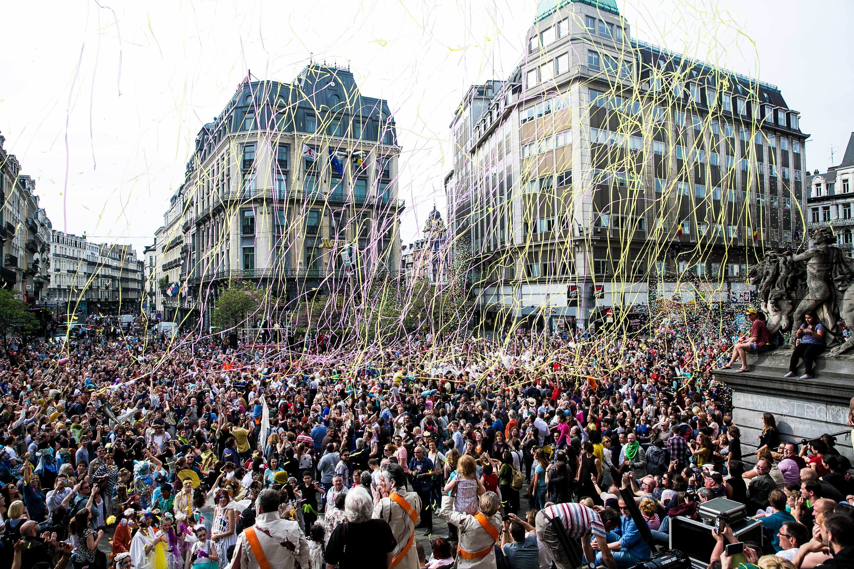
Thank you

Slide 46
Examples for Community involvment beyond the cultural districts at VEB2023
Lakossági és közösségi bevonás példái a kulturális
negyedeken túl a veszprémi EKF Programban
Előadó/Presenter: Jelinkó Mónika VEB2023

Slide 47
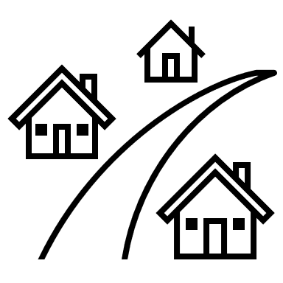






Témák
1. Jutasi Piknik Projekt
2. EKF közTÉR
3. Városrészi Baráti Körök
1. Jutasi Picnic Project
2. Community Hubs
3. Városrészi Baráti Körök

Slide 48
Jutasi Piknik Projekt
Közösségi bevonás a veszprémi Jutasi úti lakótelepen
Jutasi Picnic Project
Community involvment in housing estate
of Veszprém

Slide 49
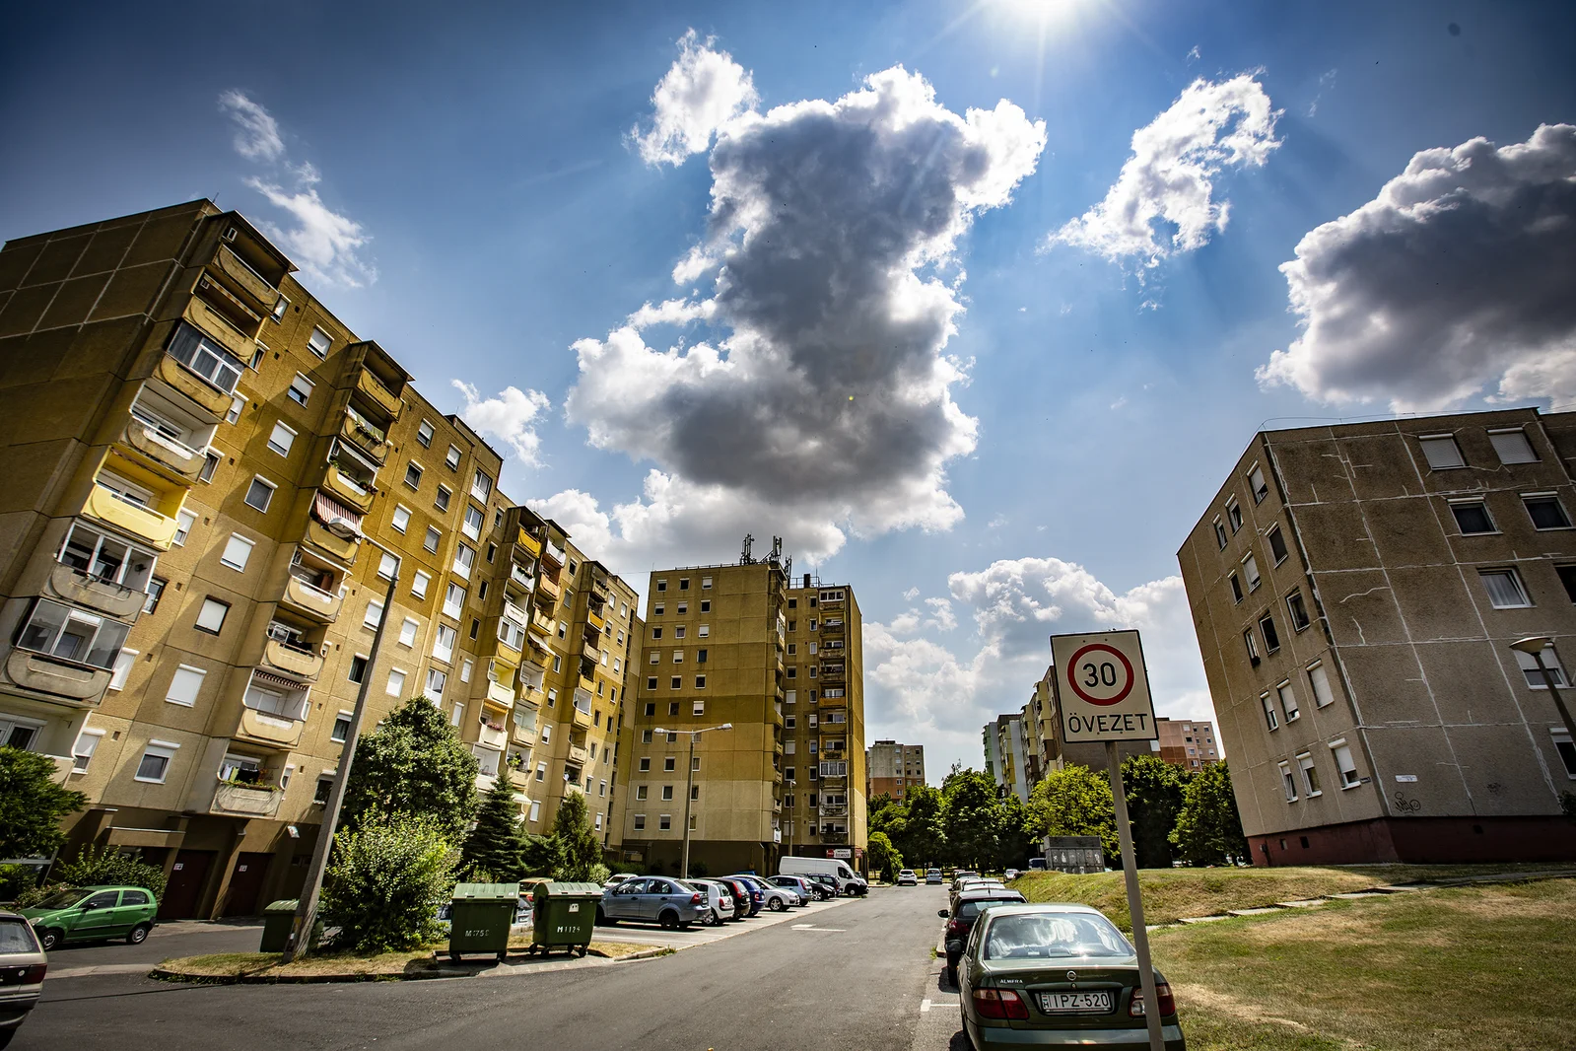

Slide 50

Célok:
Helyi identitás és kohézió erősítése a helyi lakossági bevonásával
Közösségépítés és közösségfejlesztés
Célok/Aims
Aims:
Strengthening local identity and cohesion, with a particular focus on resident involvement
community building and community development

Slide 51
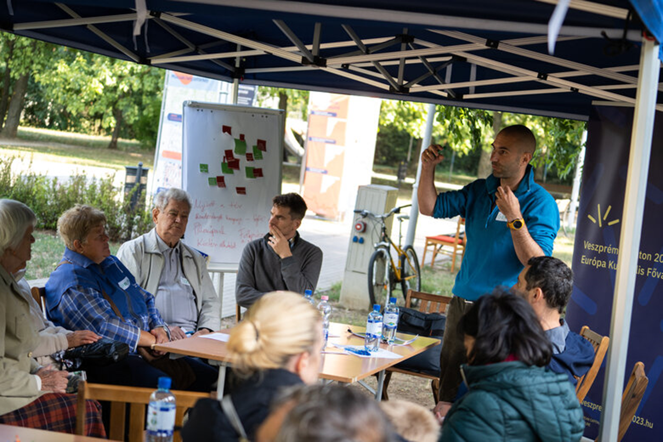
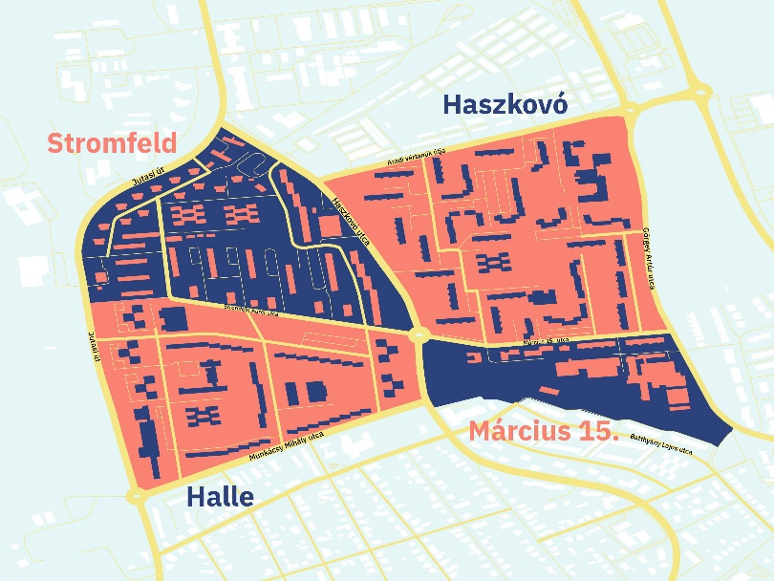
Közösségi tervezés Community planning
Cél: Közterek funkcióinak meghatározása az épülő futókör mentén (infrastrukturális beruházás) közösségi tervezéssel.
2021.

Slide 52
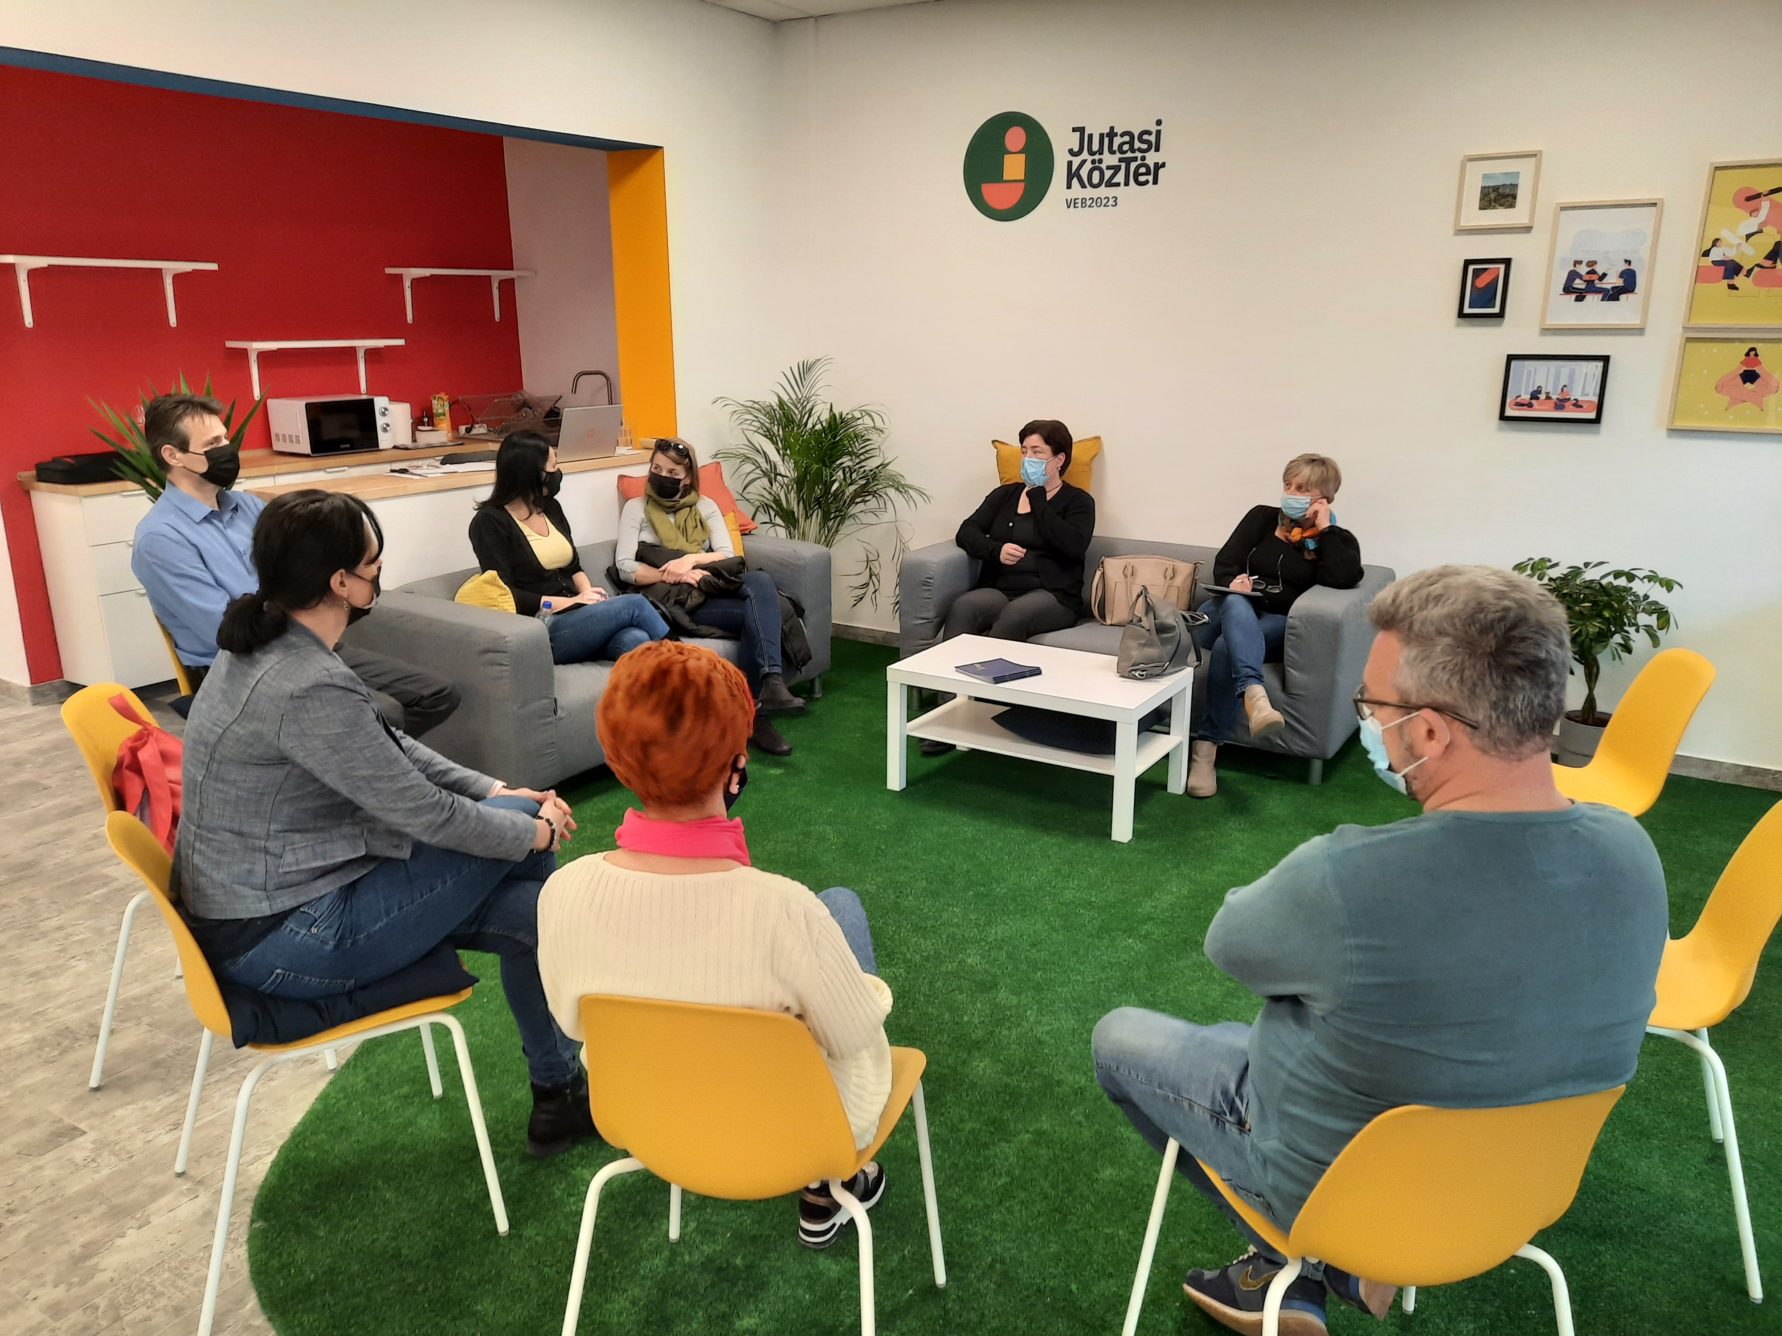
Közösség-fejlesztés/ Community development
Cél: Mikroközösségek létrejöttének támogatása különböző tevékenységek mentén
Önszerveződő és fenntartható közösségek létrehozása és támogatása
2022-2023.

Slide 53

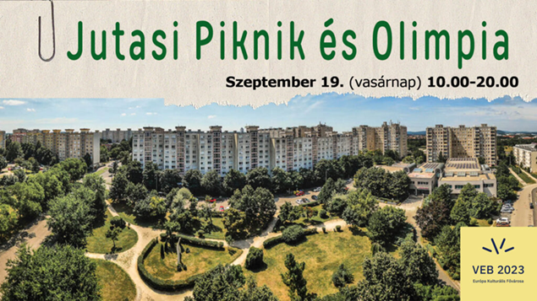
Jutasi Piknik és Olimpia /Jutasi Picnic and Olympics
Május
Június
Július
Augusztus
mini
mini
mini
mini
Szeptember
Partner:
Agóra Veszprém Kulturális Központ /
Agóra Veszprém Cultural Centre
cirkusz
olimpia
család

Slide 54
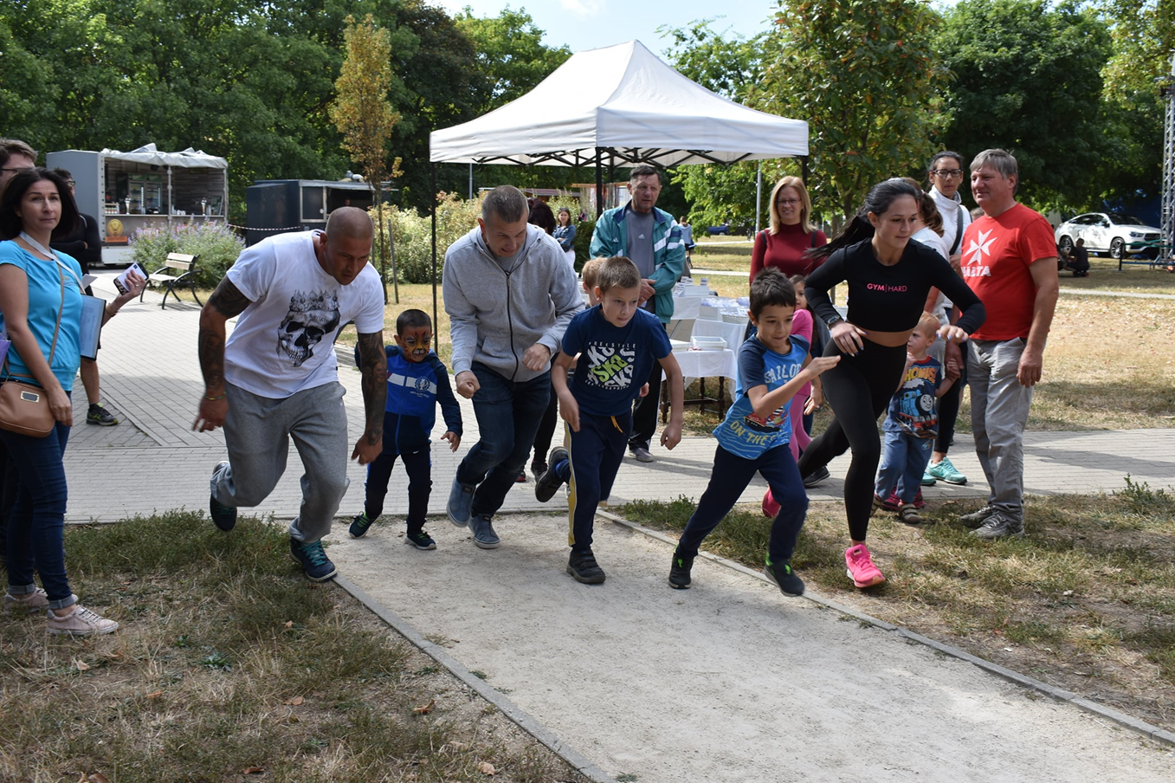

Slide 55
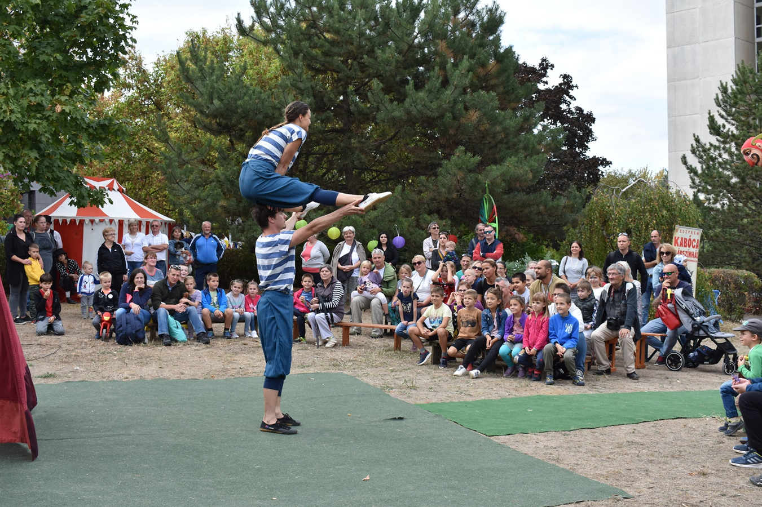

Slide 56
Közösségi cirkusz /Social Circus
Aims:
Involvementof the population, including
young people through community circus
2. Operation of self-active groups and clubs in the area of Jutasi with the help of professionally trained animators
3. Involvement of children and families through community circus
Célok:
1. A lakosság bevonása, beleértve a fiatalokat is, a közösségi cirkuszon keresztül
2. Öntevékeny csoportok és klubok működtetése Jutasi területén szakképzett animátorok segítségével.
3. A gyermekek és családok bevonása a közösségi cirkuszon keresztül

Slide 57
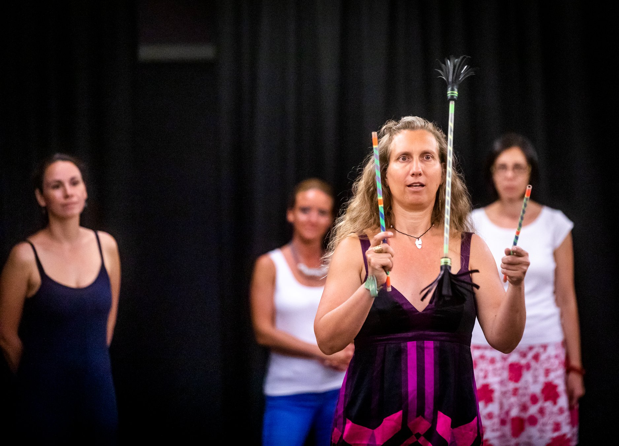

Cirkollektív
Partner: Magyar Zsonglőr Egyesület /
Hungarian Juggling Association
Célcsoport: bárki 7 év felett
Target group: anyone over 7 years
2021-2023.

Slide 58
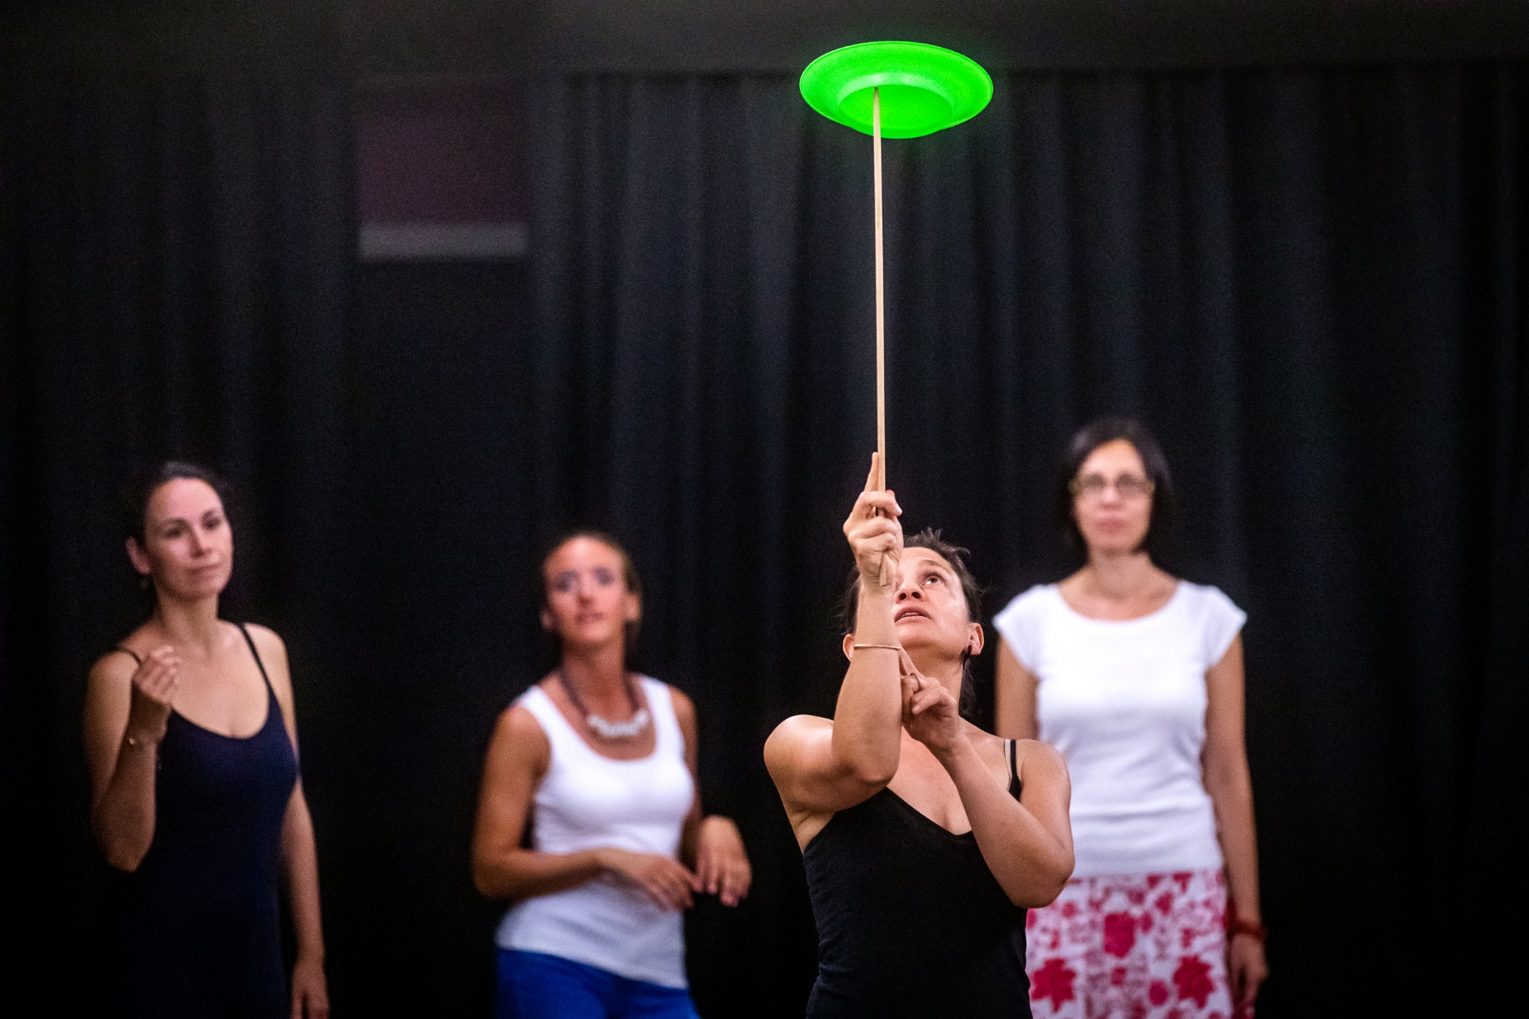
Jutasi Circus

Slide 59
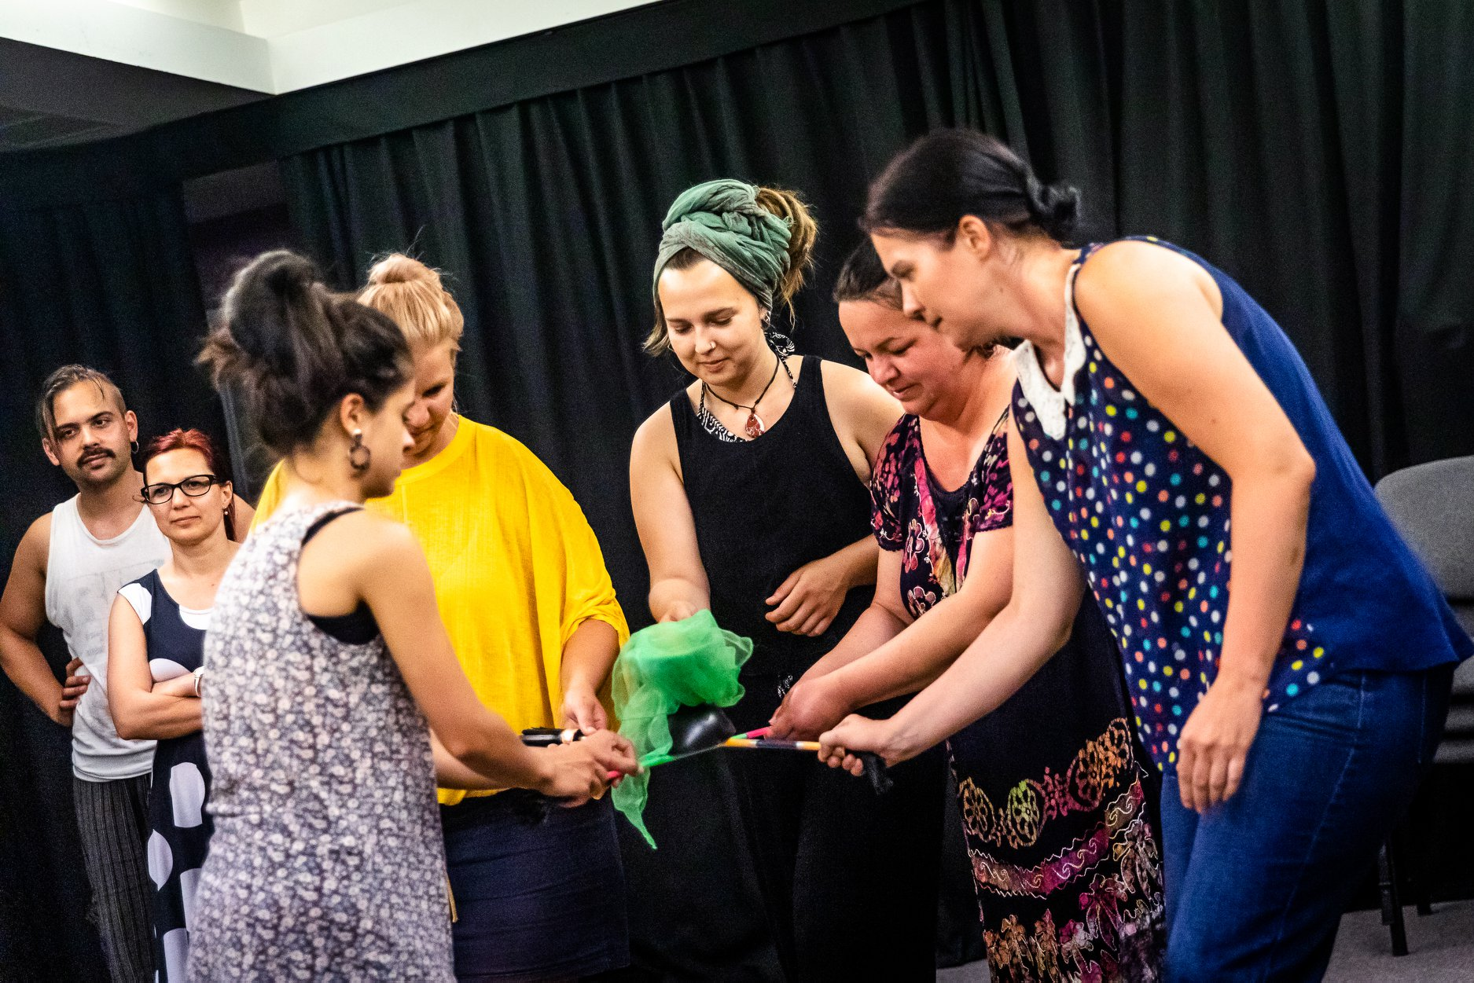

Slide 60
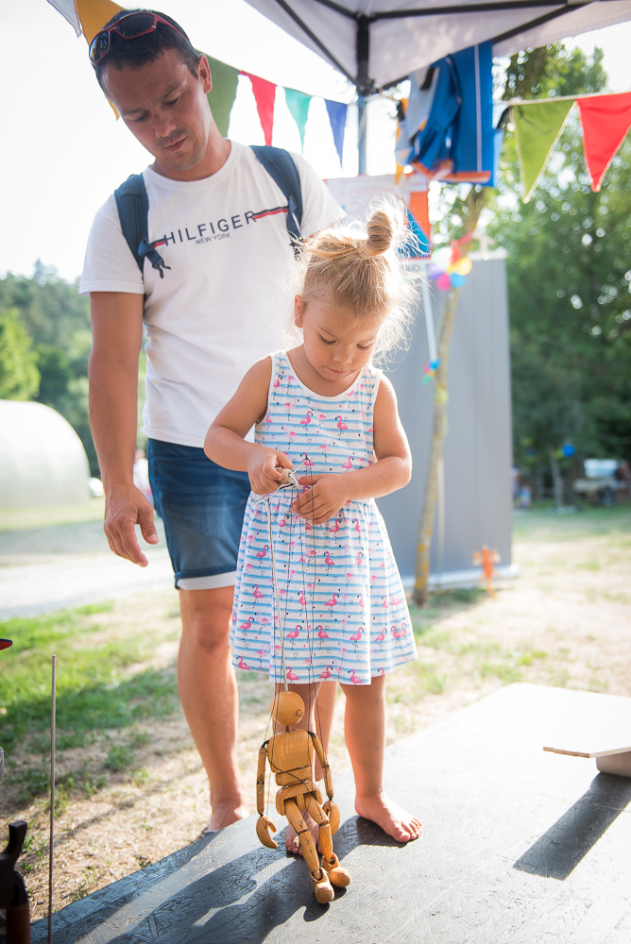

Partner: Kabóca Bábszínház/
Kabóca Puppet Theater
Célcsoport: Családok, 7 év alatti gyermekek
Target group: families, kids, under 7 years
2021-
Cirkuládé

Slide 61
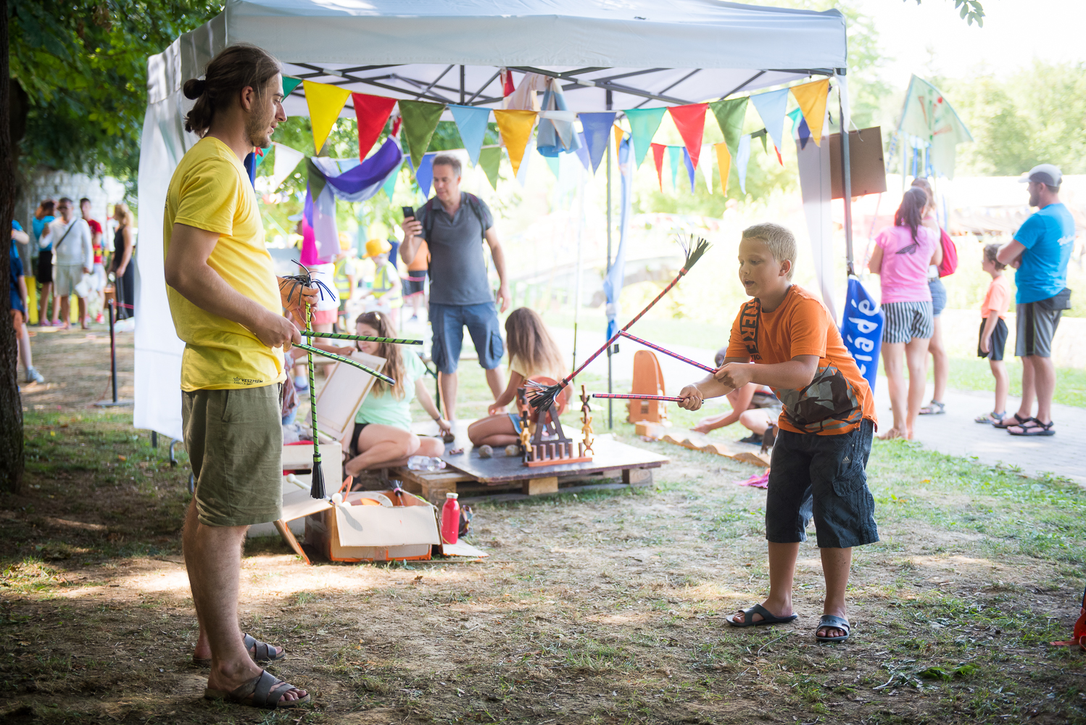

Slide 62
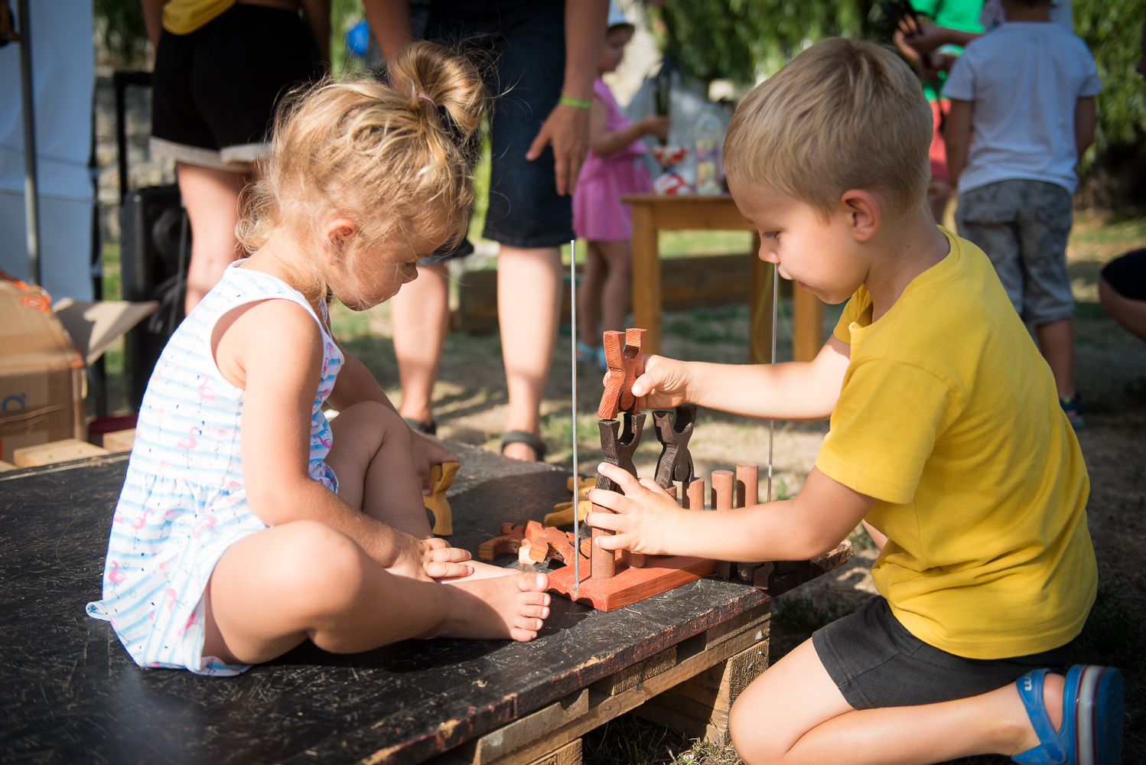

Slide 63
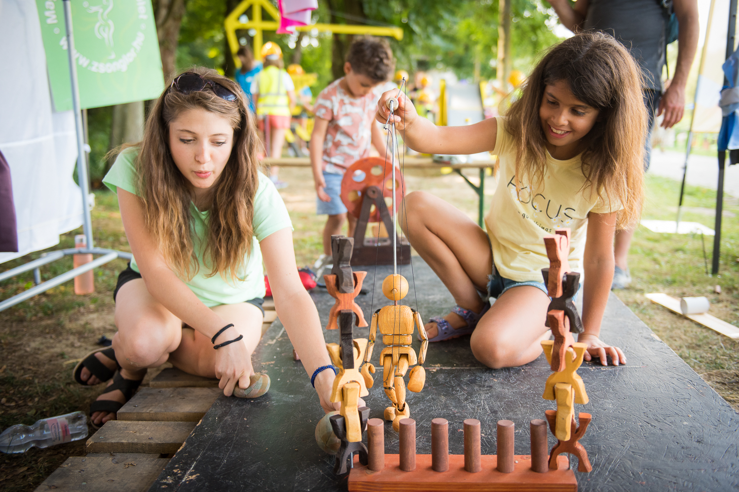

Slide 64
EKF közTÉR / Community Hubs

Slide 65

EKF közTÉR / Community Hubs
Célok:
KÖZÖSSÉGÉPÍTÉS
INFORMÁCIÓ​
SZELLEMISÉG​
TALÁLKOZÁSI PONT
Aims:
COMMUNITY BUILDING
INFORMATION​
VALUES​
PLACE TO MEET & CREATE

Slide 66
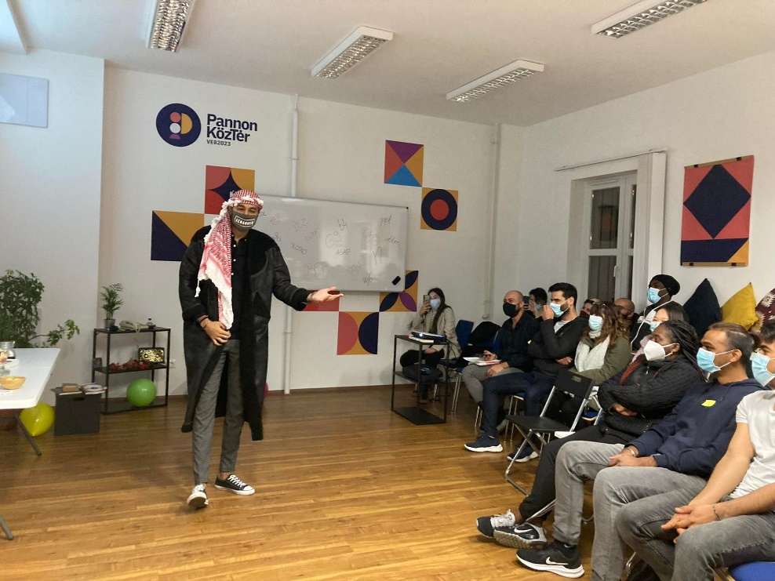

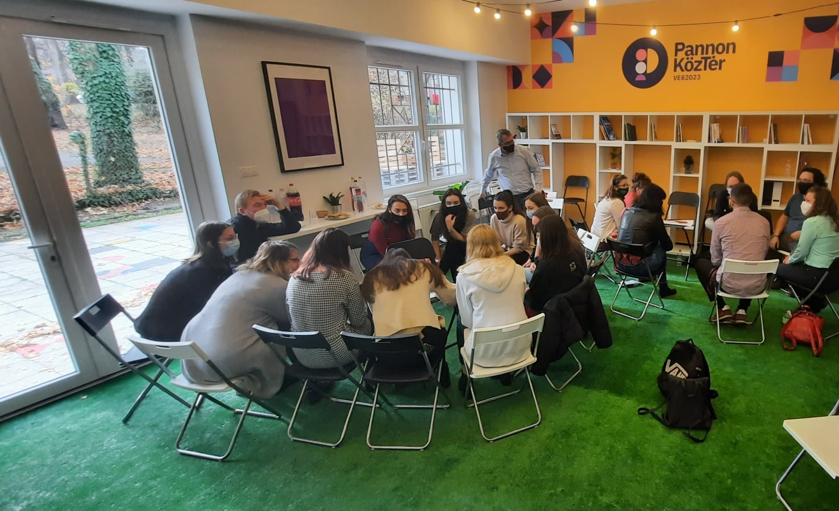
PANNON közTÉR (Pannon Egyetem E épület)
www.ekfpontok.hu
Generációs híd projektek bázisa
"Ők is köztünk élnek" sorozat bázisa
EKF partnerek háttérbázisa​
kihelyezett egyetemi órák, hallgatói műhelyek
PANNON Community Hub ​
Base for Generation Bridge projects
Base for the "They live among us" series
Back office base for ECoC partners

Slide 67
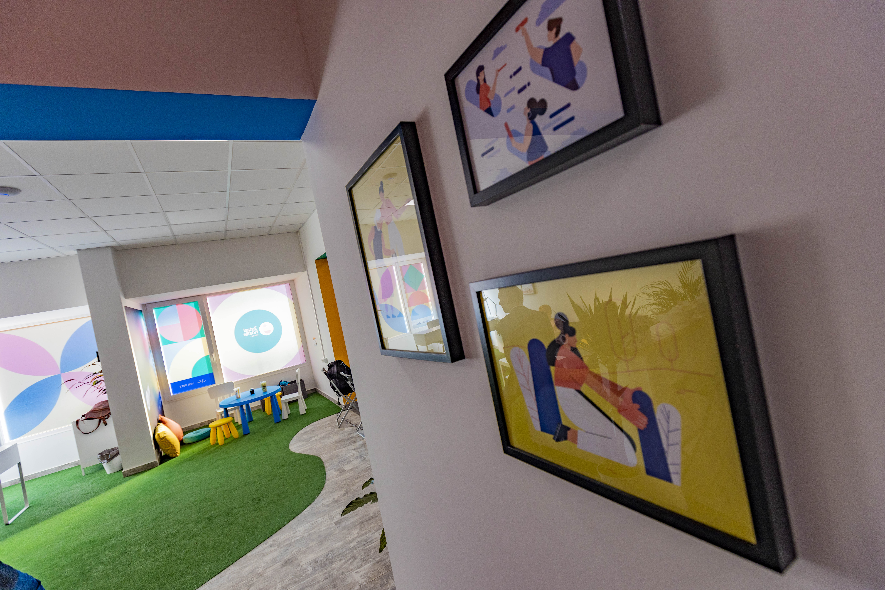

2.Jutasi Köztér/
Community Hub
(Március 15. u. 2/A)
Cél: EKF közösségi programok szervezése
Helyet adni önszerveződő és mikroközösségeknek, Jutasi Piknik programjainak

Slide 68
Városrészi baráti körök /
District Friends’ Associations

Slide 69

Városrészi Baráti Körök​
12 városrész (közös történelmi gyökerek vagy földrajzi
behatárolás alapján) Veszprémben
2021-ben műhelymunkák
12 districts/neighbourhoods (based on common historical roots or geographical delimitation) in Veszprém
Workshops in 2021:
Célok
közösség-és kapcsolatépítés a városrészekben és városrészek között is
Identitástudat fejlesztése, szimbólumrendszerek meghatározása, ábrázolása (zászlókon, sálakon – azonosíthatóság, önkifejezés)
Városi ünnepségekbe való intenzívebb bekapcsolódás (pl.Gizella Napok)
Régi hagyományok felélesztése: Hídünnep
Újak népszerűsítése: Városi Kertkávézók kiterjesztése több városrészere
Aims
community and relationship building within and between neighbourhoods
Developing a sense of identity, defining and representing symbol systems (on flags, scarves - identification, self-expression)
Involvement in city celebrations (e.g. Gizella Days)
Reviving old traditions: the Bridge Festival
Promoting new things: extending the Urban Garden Cafés to further parts of the city

Slide 70

Városrészi Baráti Körök
​
2022-ben sikeres EKF pályázat, aminek keretében megvalósul:
Szimbólumrendszerek ábrázolása zászlókon, kendőkön
Aktív részvétel a Gizella Napokon
Híd ünnep újjáélesztése
Terv:Micrograntes pályázatból egy-egy városrész kapcsolódna a kertkávézós alkalmakhoz
Successful ECoC bid in 2022
Display of symbol systems on flags and scarves
Active participation in Gizella Days
Revival of the Bridge Festival
Plan: - Microgrant bids to link up each district/neighbourhood with the garden café events

Slide 71
Köszönöm a figyelmet!
Thank you for your attention!
VEB2023 contact: monika.jelinko@veszprembalaton2023.hu
Project manager:
laszlo.huszti@veszprembalaton2023.hu
szilvia.bonyhadi@veszprembalaton2023.hu
www.veb2023.hu

